Slide 1





Designing a prototype of a
European Forest Monitoring System
Johannes Breidenbach et. al.
job@nibio.no
https://pathfinder-heu.eu/

Slide 2

Goals of a European Forest Monitoring System (EFMS)
Reliable annual estimates of forest attributes, e.g. C-stocks & changes
Timely information
  Pan-European level
  Regions level, e.g. Mediterranean, the Alps, the Nordics, the European Union
High-resolution maps of forest attributes –
enhance estimation accuracy, detect hotspots of change quickly
Primary purpose: inform transnational-level policymaking
Other uses: support local decision making, research,
enhance business opportunities

Slide 3
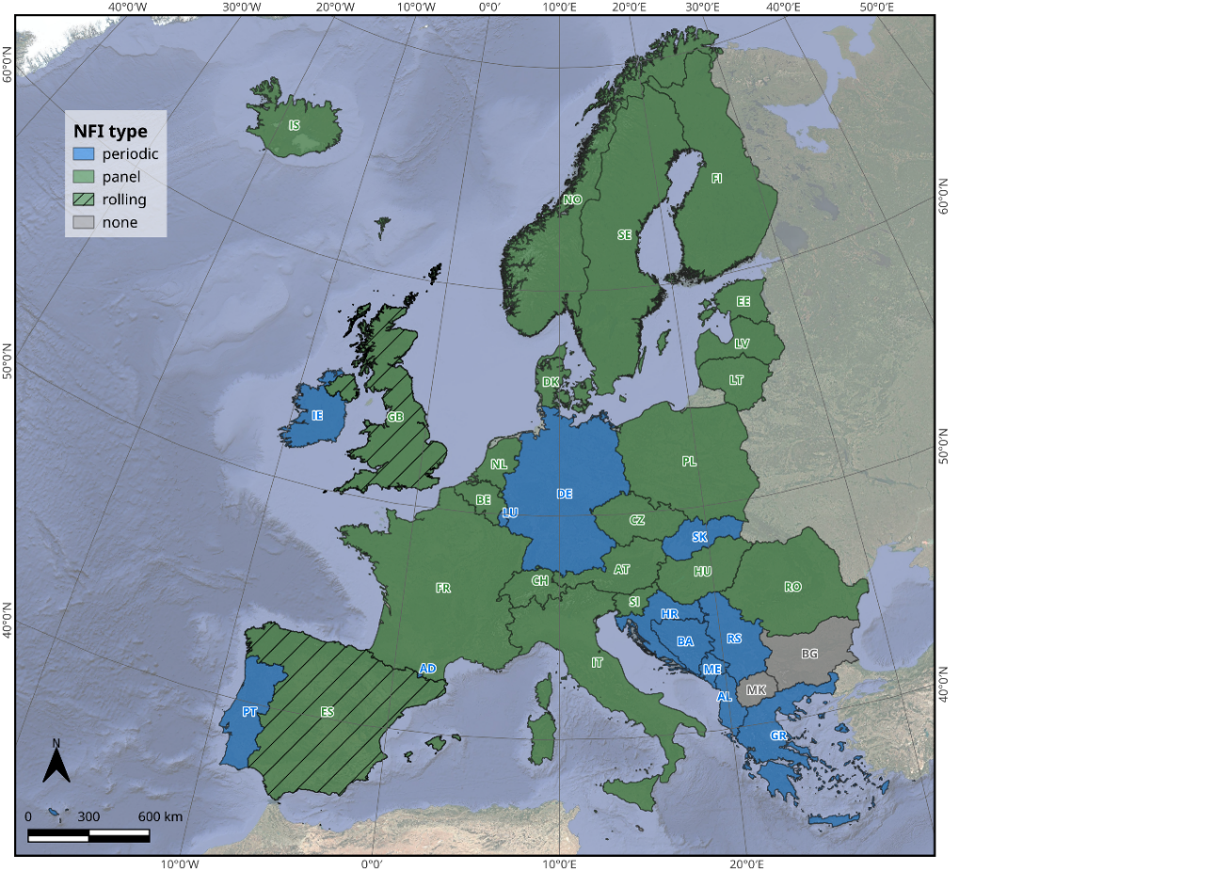
Most of Europe is annually covered by NFI data…
… economically efficient to use these data also in a EFMS
Curtsey Ryan Carroll, Uni Goettingen

Slide 4
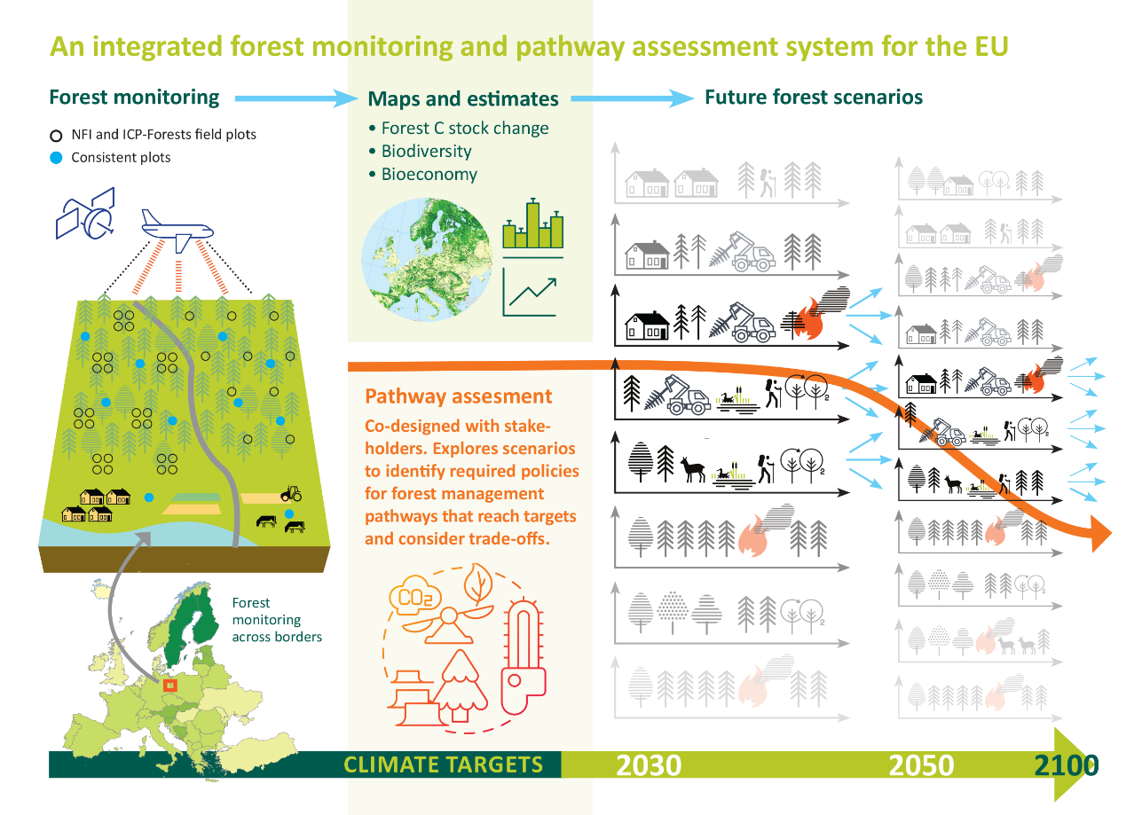

Aim: Prototype of a European Forest Monitoring System (EFMS)
A bottom-up system integrating NFIs/ICPF and remote sensing
Harmonized European and national forest information

Slide 5
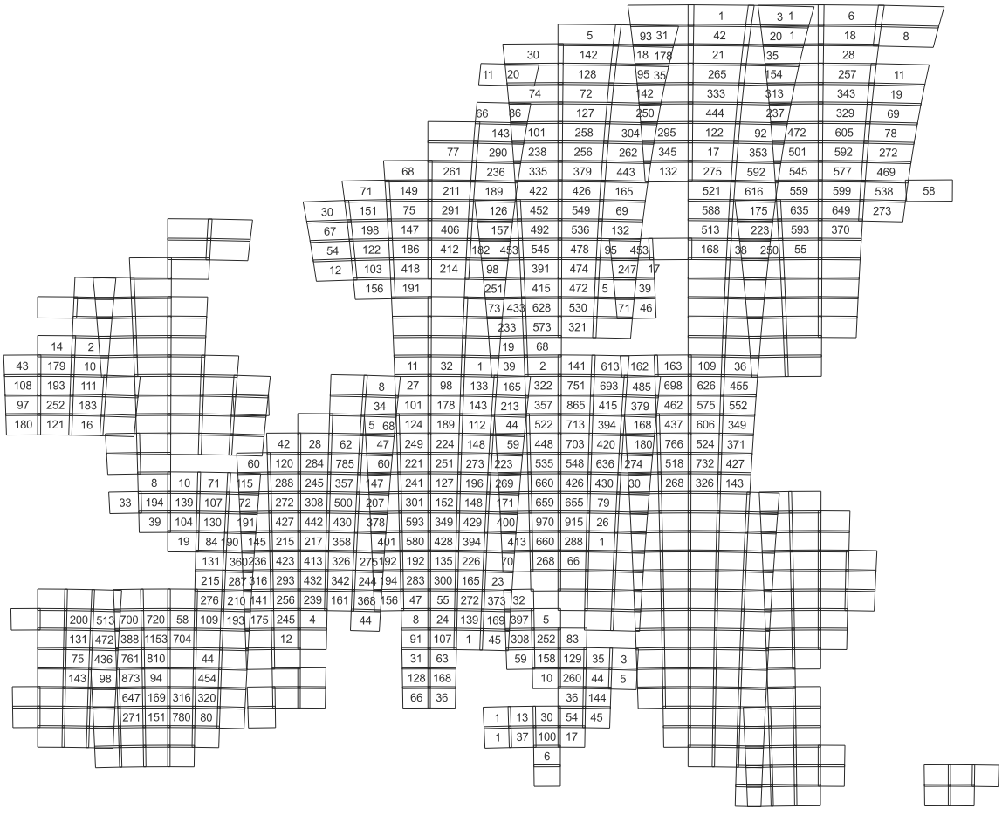
Harmonized NFI data combined with
Sentinel2 data
Country | FB1 | FB2 (DBH, SC) | FB3 (BA) | FB4 (H) | FB5 (gai/nai)
AT | 5749 | 1482 | 1482 | 1482 | 1317
BE | 1061 | 1061 |  |  | 499
CH | 2624 | 2624 | 2624 |  | 2170
CZ | 5022 | 5021 | 5021 |  | 2206
DE | 6186 | 6186 | 6186 | 6186 | 5799
ES | 14454 | 14259 | 13875 | 13875 | 8377
FI | 16545 | 16545 | 16545
FR | 15845 | 15845 | 15845 | 15845
IE | 1509 | 1509 | 1509 | 1509 | 1489
IT | 6688 | 6656 |  |  | 6536
NO | 7024 | 6575 | 6575 | 6575 | 6705
PL | 18802
SE | 17299 | 17299 |  |  | 9973
SI | 736
 | 119544 | 95062 | 69662 | 45473 | 45071
Curtsey Jukka Miettinen, VTT

Slide 6
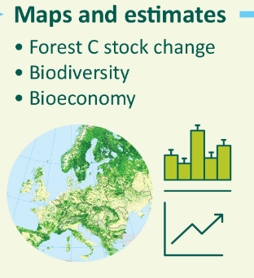
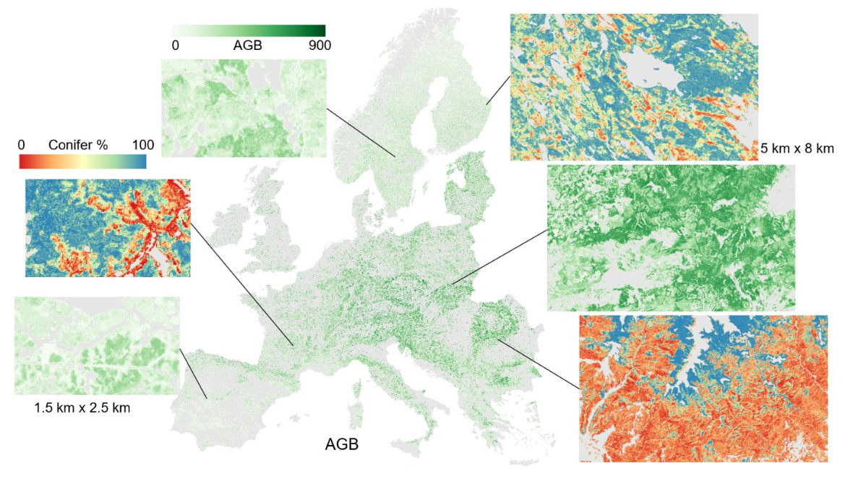
Mapping and estimation
Pan-European maps combining NFI and sattellite data for 2020
10 m resolution

Slide 7
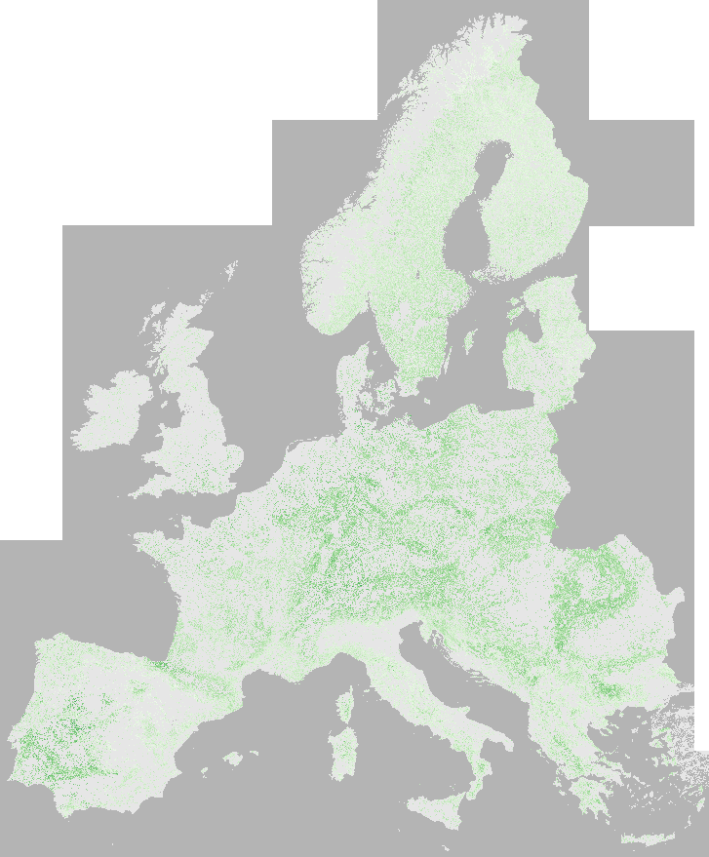
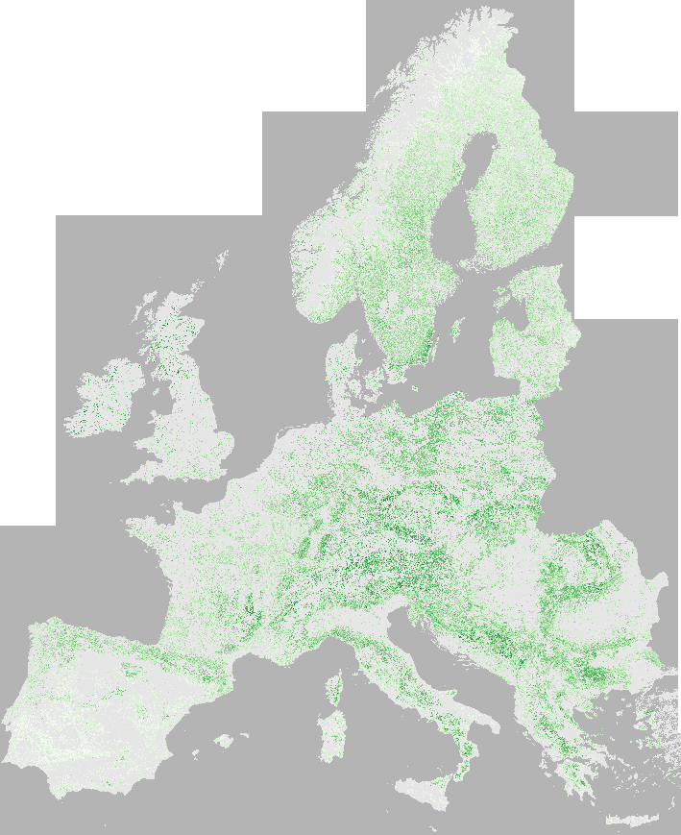
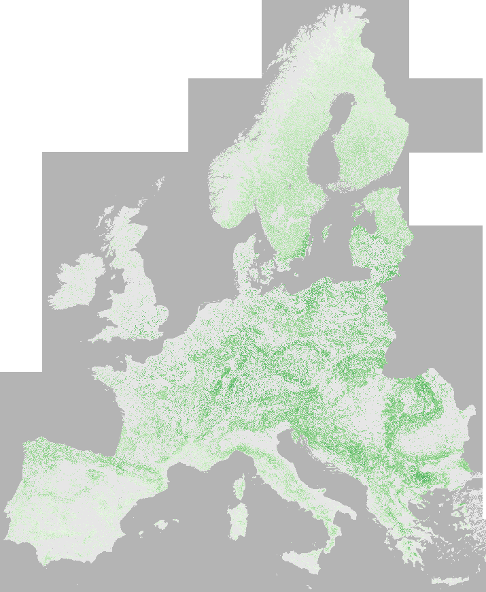
For each 10 m pixel:
Predicted value and uncertainty
-Increment
Mean DBH
0 H (dm) 500
Basal Area
Height
0 BA (m2/ha) 70
0 DBH (cm) 80
Curtsey Jukka Miettinen, VTT
Notes:
Text slide (v.1)

Slide 8
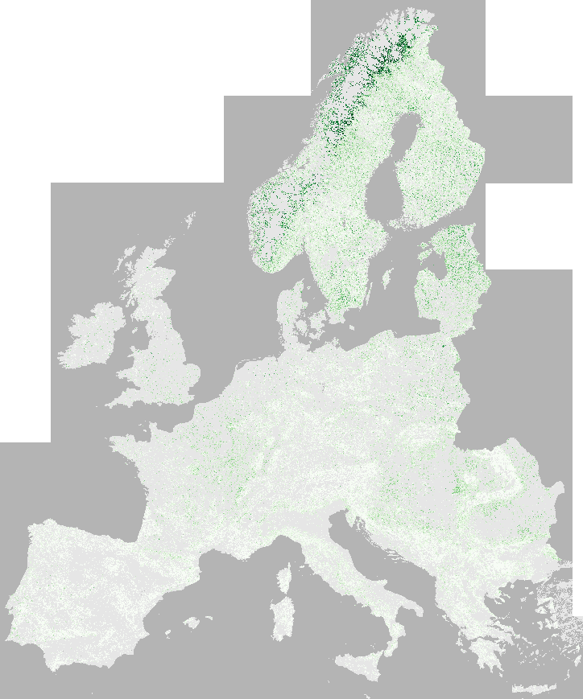
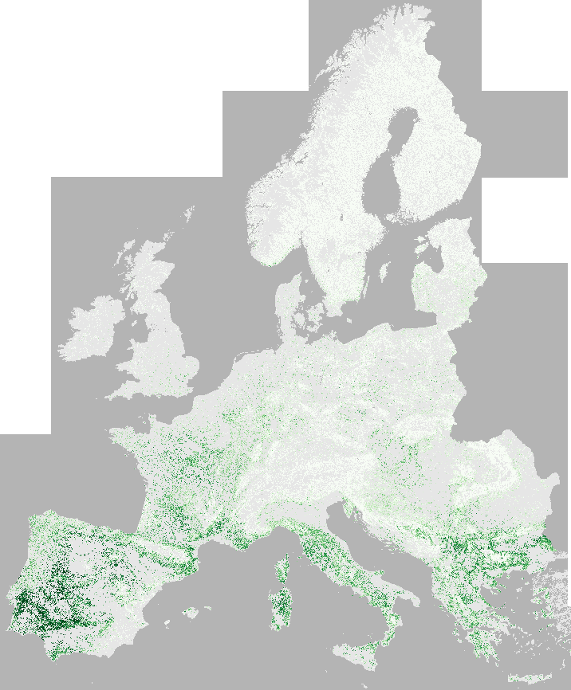
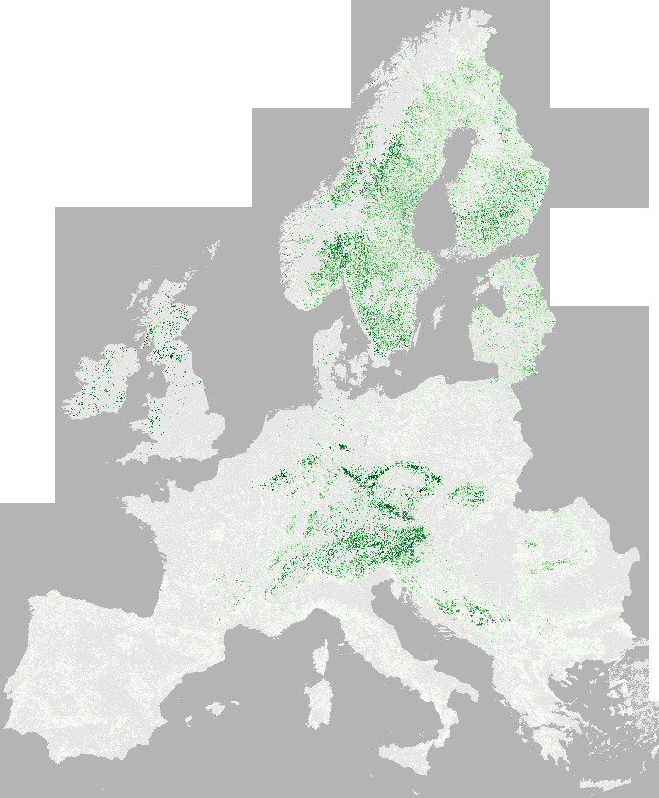
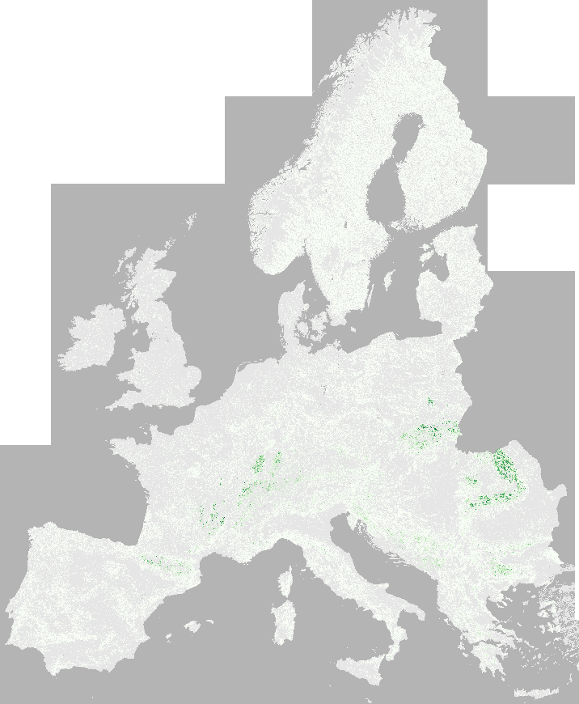
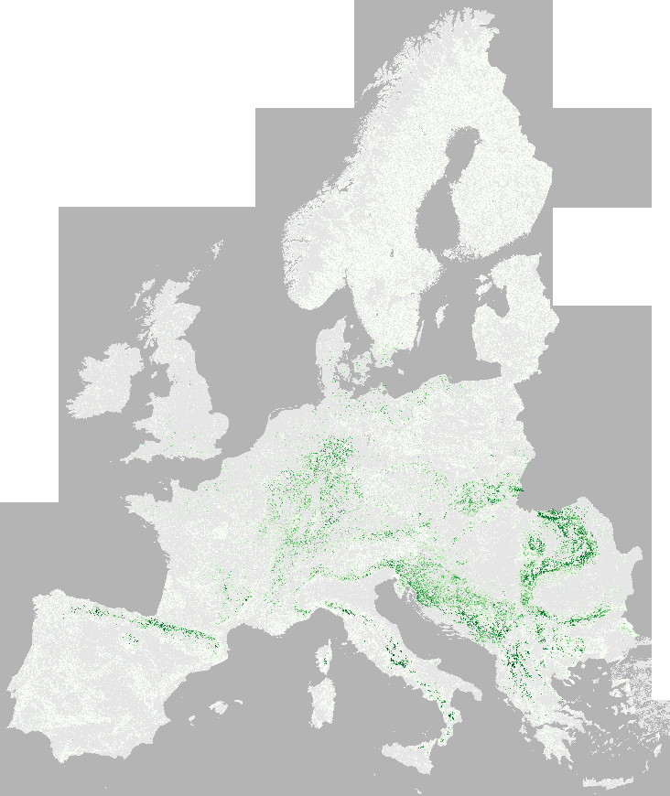
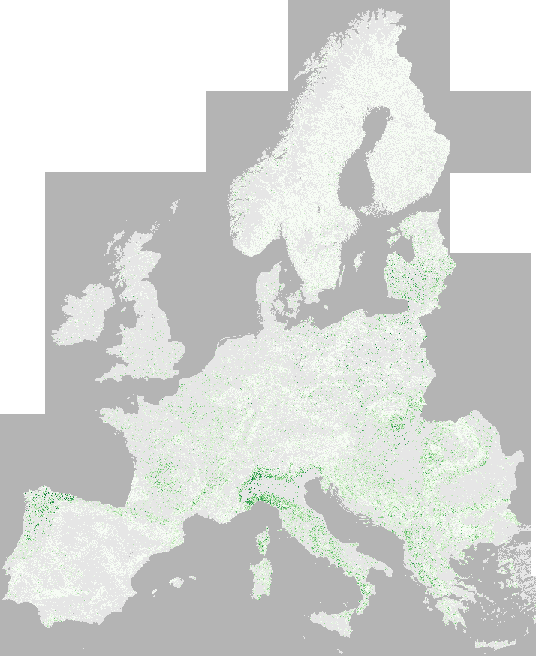
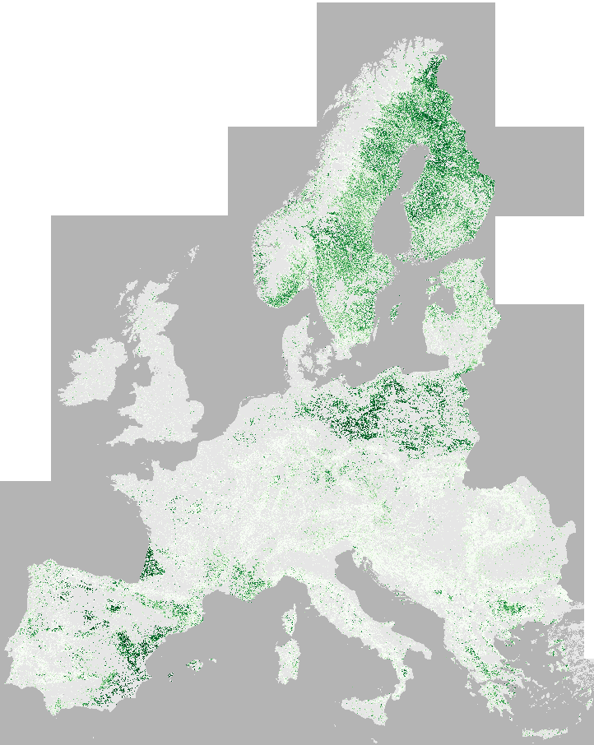
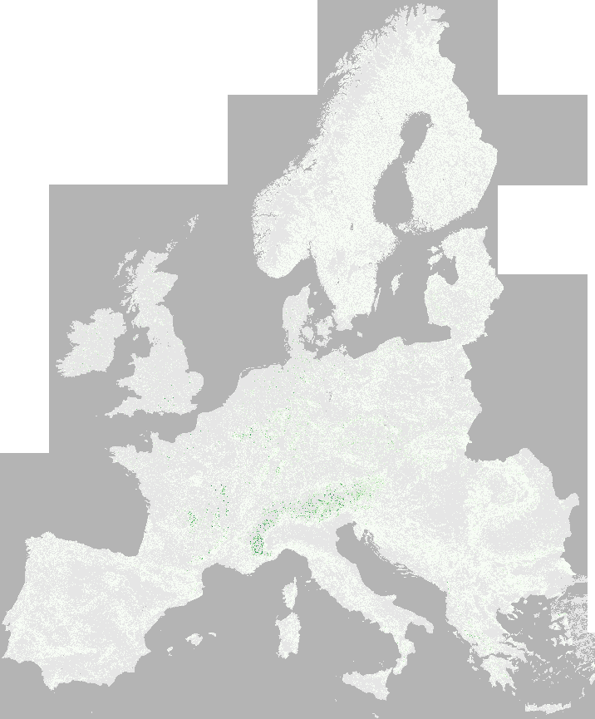
Bet_Car_Fra
0 % 100
Quercus
Picea
Abies
Fagus
OthBL
Pinus
OthCon
Notes:
Text slide (v.1)

Slide 9
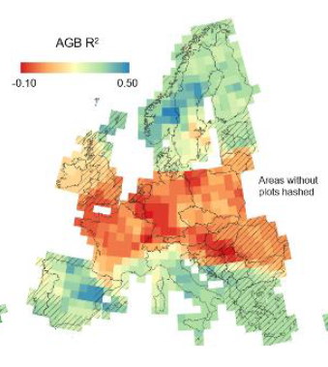
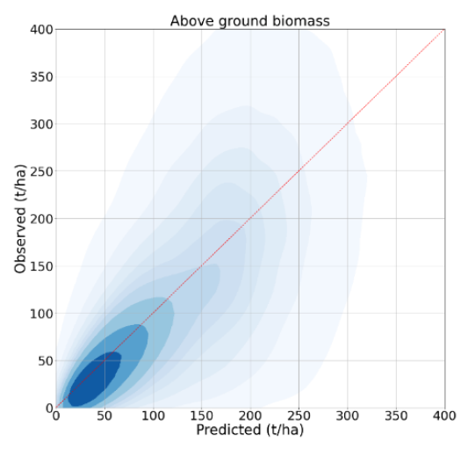
General trends in mapping uncertainty
kNN method – preserves covariation among MV responses
Lower map accuracy in central Europe than in north and south
Bias in extreme values
➔ Pixel counting not advised – therefore plot-based (model assisted) estimates

Slide 10
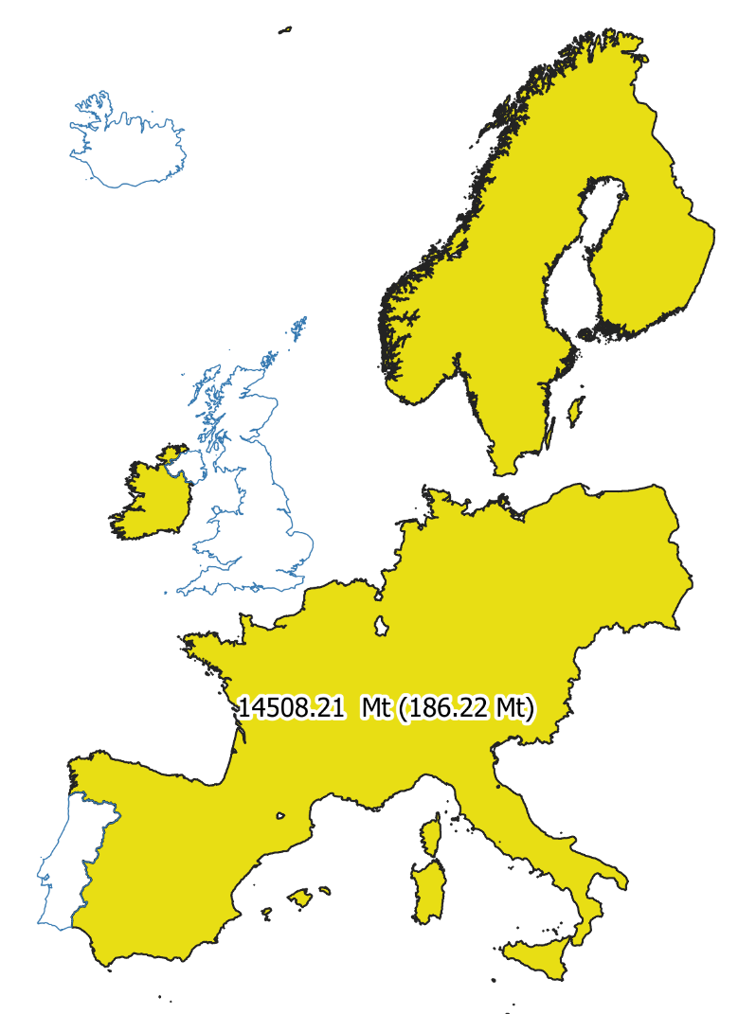
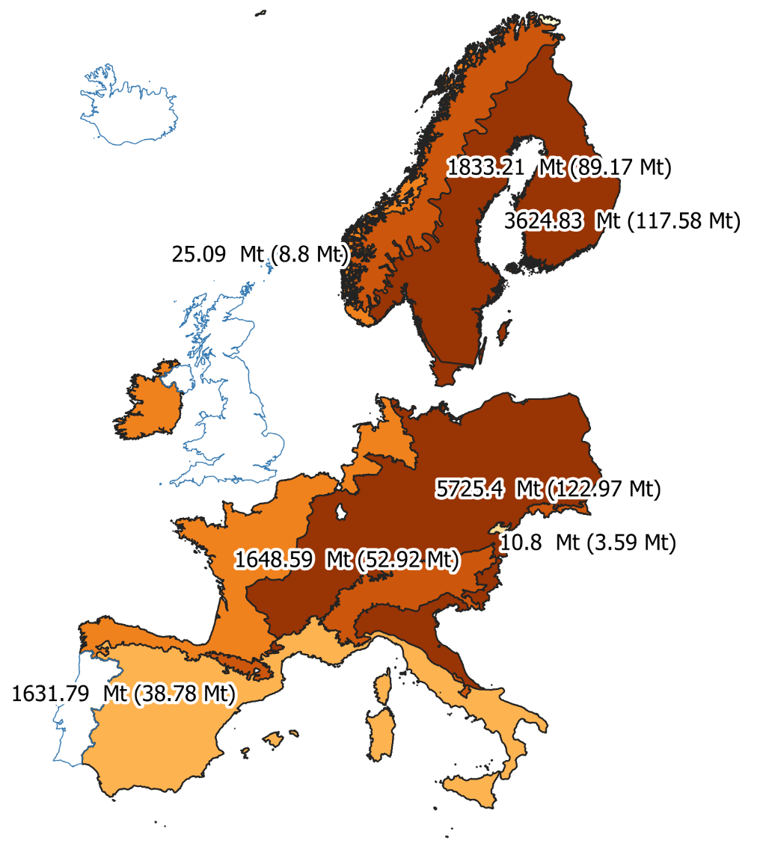
Reliable estimates
AGB
Curtsey Radim Adolt, Ivo Kohn, Jan Maslo, NLI - Czech Forestry Institute
Notes:
Cartogram

Slide 11
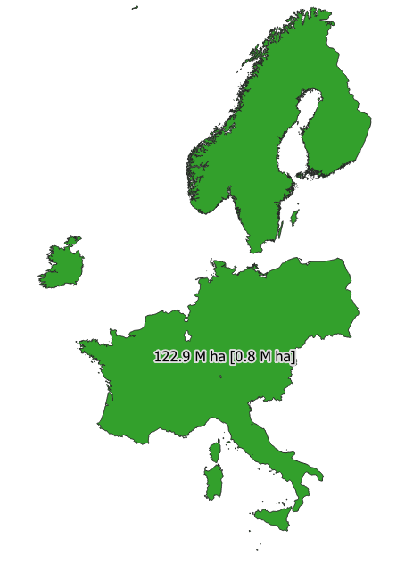
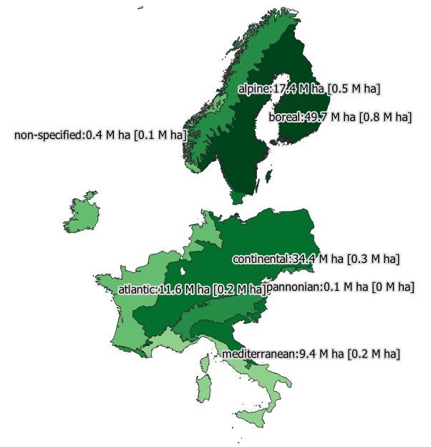
Reliable estimates
Forest area
Curtsey Radim Adolt, Ivo Kohn, Jan Maslo, Czech Forestry Institute
Notes:
Cartogram

Slide 12
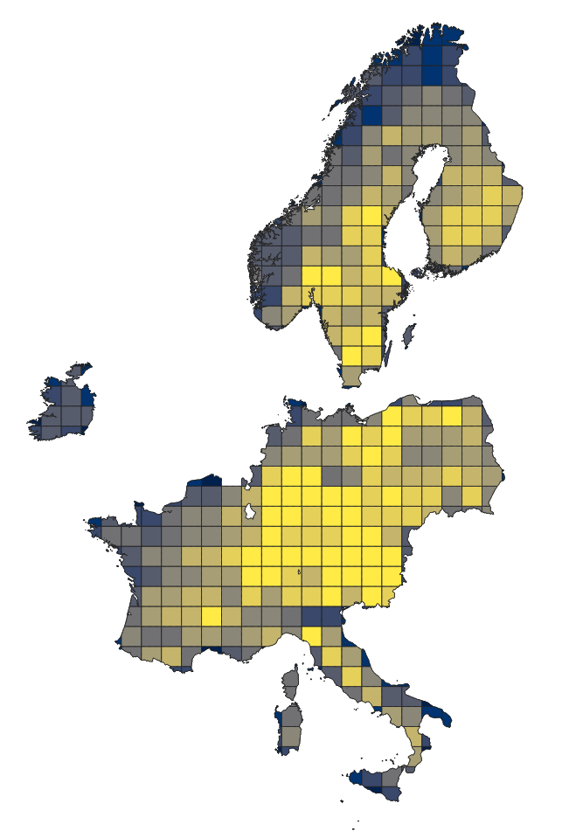
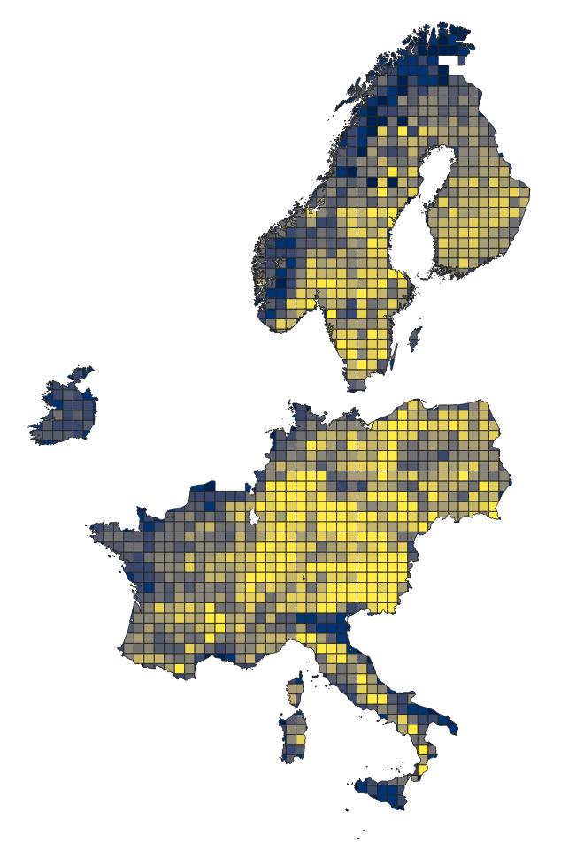
Reliable estimates
Biomass stock (AGB)
INSPIRE 100 km
INSPIRE 50 km
Curtsey Radim Adolt & Jan Maslo, Czech Forestry Institute

Slide 13
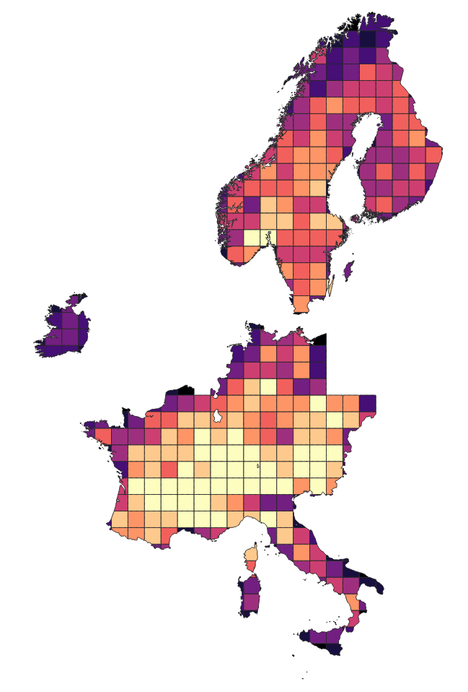
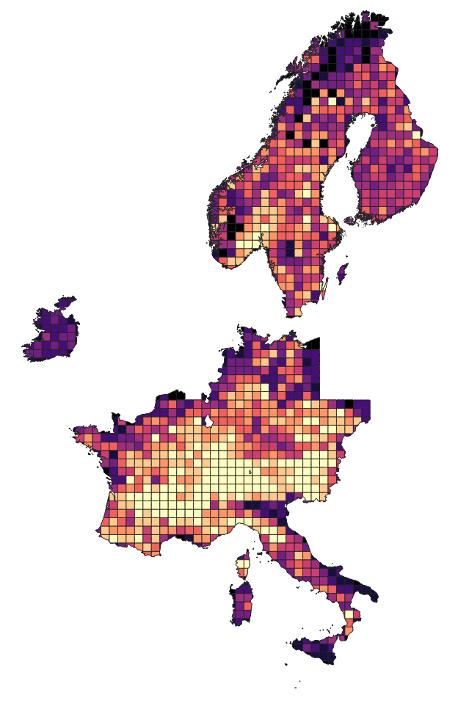
Reliable estimates
Deadwood
Curtsey Radim Adolt & Jan Maslo, Czech Forestry Institute

Slide 14
Summary - estimation
Centralized NFI database analyzed with nFIESTA
AGB C-stock changes of 1% can be detected reliably
Shown results only plot-based
Adding EO information can reduce SE by up to 30% for some attributes
➔ Not all countries yearly coverd with NFI field plots
Curtsey Radim Adolt, Ivo Kohn, Jan Maslo, NLI - Czech Forestry Institute
Notes:
Cartogram

Slide 15
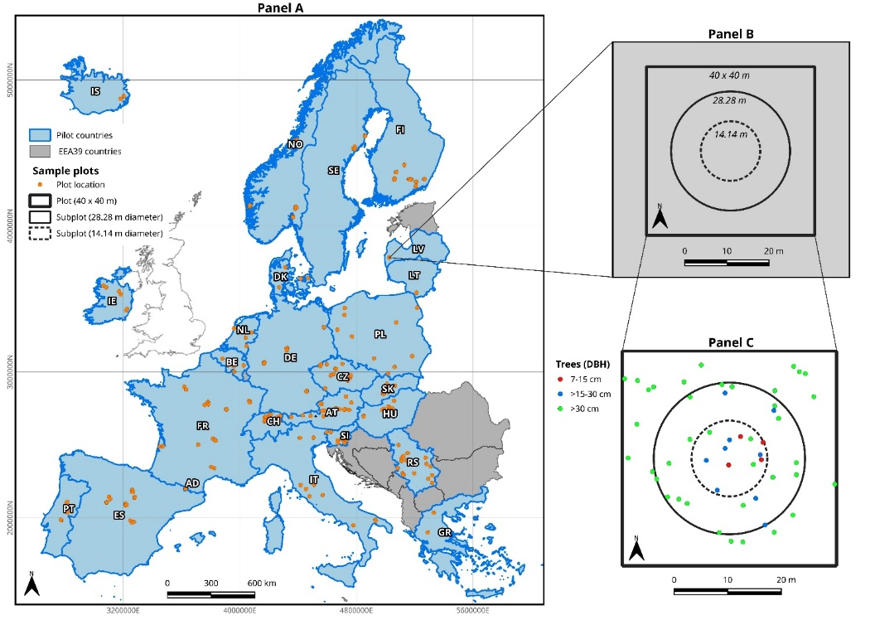
Standardized EO-friendly plots if yearly data are not available
Curtsey Ryan Carroll, Uni Goettingen

Slide 16
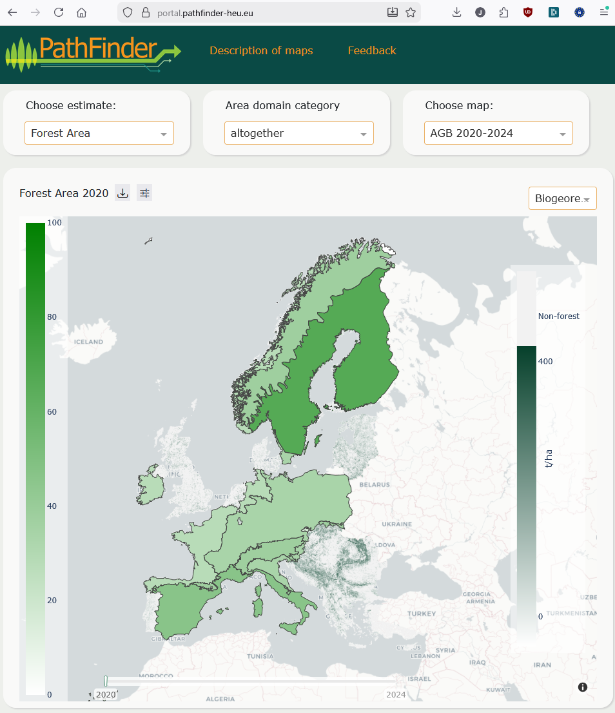
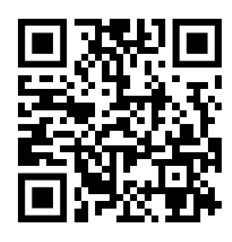
View and download data from the PathFinder portal
Answers questions like:
-How much pine biomass with diameters > 50 cm per biogeographic region?
-How much forest in the Mediterranean?
(Stay tuned!)

Slide 17
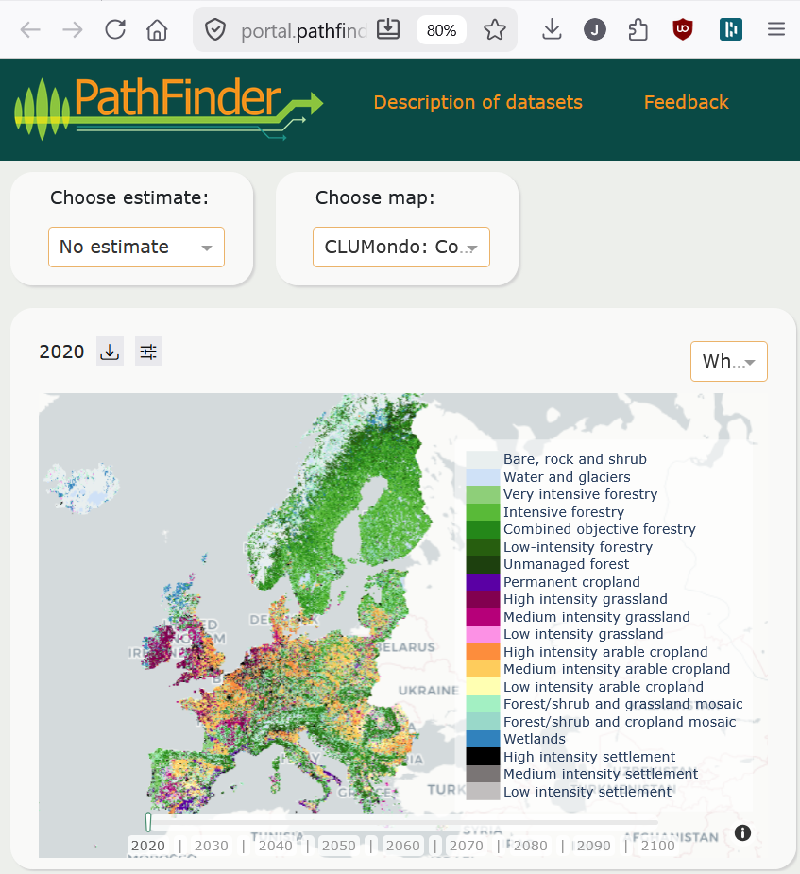
PathFinder portal: a time machine
Scenarios for
Land-use change (CLUmondo)
Forest productivity (GPPx)
Forest structure (PixSimEU)
Disturbance risk (ForestGales)
Biodiversity indicators
(Stay tuned!)

Slide 18
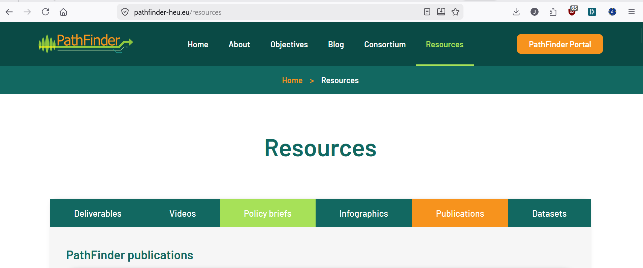

Many more outcomes…
Development and comparison of AI models
A forest-sensitive climate emulator
New statistical estimators
Models for soil C development
Consistent LULUCF
reporting
Horizon Europe GA number 101056907

Slide 19
Conclusions
EUFEMIA
A European Forest Monitoring System based on National Forest Inventories and ICPF is feasable
EUFEMIA – European Forest Monitoring and Analysis system
Combining field and remote sensing data
improves maps and estimates
RS-based maps can give a timely first impression and are useful for mapping disturbances
Important decisions should not be based on pixel counts of maps – combine with in situ!
We need institutional arrangements to proceed
Horizon Europe GA number 101056907

Slide 20

How to proceed…
PathFinder prototype
Required governance development:
ENFIN Association with a mandate to provide European forest information
In collaboration with EU commission
MS commit to provide data/information
Implementation
EUFEMIA

Slide 21

Thanks for listening – please support us by following our channels!
https://www.linkedin.com/company/eupathfinder
https://pathfinder-heu.eu/
https://youtu.be/sPBuOGpDraE
https://linktr.ee/eupathfinder

