Slide 1


WP3 & WP4
Niek Scherpenhuijzen (VUA)
Rasmus Astrup (NIBIO)
Daniel Di Marzo (ALUFR)
Funded by the European Union. Views and opinions expressed are however those of the author(s) only and do not necessarily reflect those of the European Union or the European Climate, Infrastructure and Environment Executive Agency (CINEA). Neither the European Union nor the granting authority can be held responsible for them.
Notes:
Section title

Slide 2
WP3: Forest modelling framework
I
III
Forest management map
CLUMondo
II
IV
Forest management scenarios
PixSim
Funded by the European Union. Views and opinions expressed are however those of the author(s) only and do not necessarily reflect those of the European Union or the European Climate, Infrastructure and Environment Executive Agency (CINEA). Neither the European Union nor the granting authority can be held responsible for them.
Notes:
Aim: Develop a modelling framework to analyze the impact of policy decisions and resulting management actions on the future supply of forest ecosystem services

Slide 3

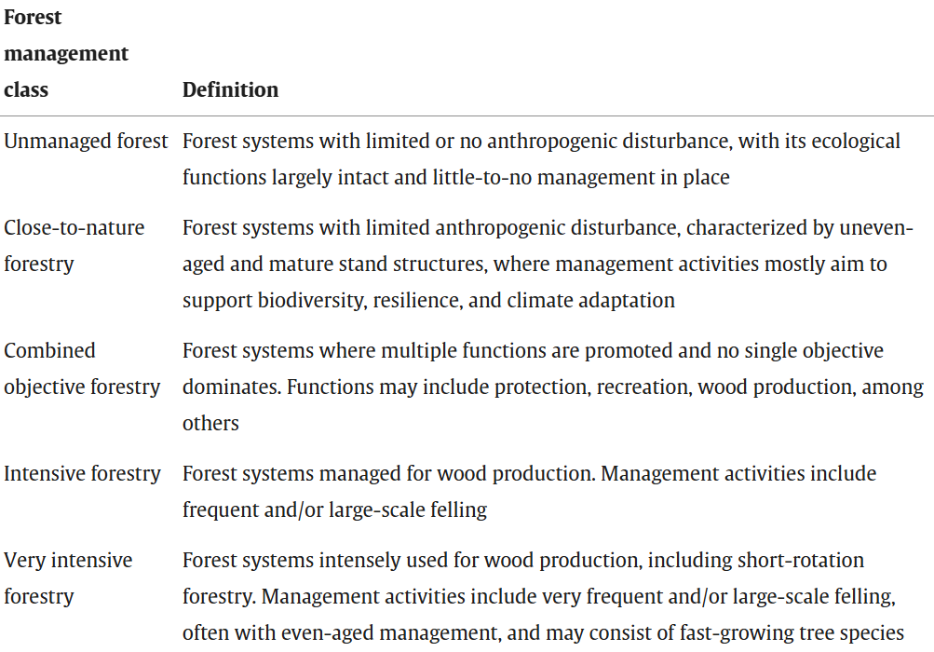
Forest management map
Funded by the European Union. Views and opinions expressed are however those of the author(s) only and do not necessarily reflect those of the European Union or the European Climate, Infrastructure and Environment Executive Agency (CINEA). Neither the European Union nor the granting authority can be held responsible for them.
Notes:
Blank page slide for any use (more text, figures/charts, photos, etc.) - still mandatory to keep the logo, EC flag, and funding disclaimer

Slide 4
Forest management scenarios
Stakeholder document analysis
  Confederation of European Forest Owners (CEPF, 2023) -> Participatory forest stewardship
  Confederation of European Paper Industries (CEPI, 2017) -> Competitive forest industry
  European State Forest Association (EUSTAFOR, 2024) -> Multifunctional forests
  World Wide Fund for Nature (WWF, 2025) -> Biodiversity focused forests
Stakeholder workshops and survey
  Validation
Funded by the European Union. Views and opinions expressed are however those of the author(s) only and do not necessarily reflect those of the European Union or the European Climate, Infrastructure and Environment Executive Agency (CINEA). Neither the European Union nor the granting authority can be held responsible for them.
Notes:
Blank page slide for any use (more text, figures/charts, photos, etc.) - still mandatory to keep the logo, EC flag, and funding disclaimer

Slide 5
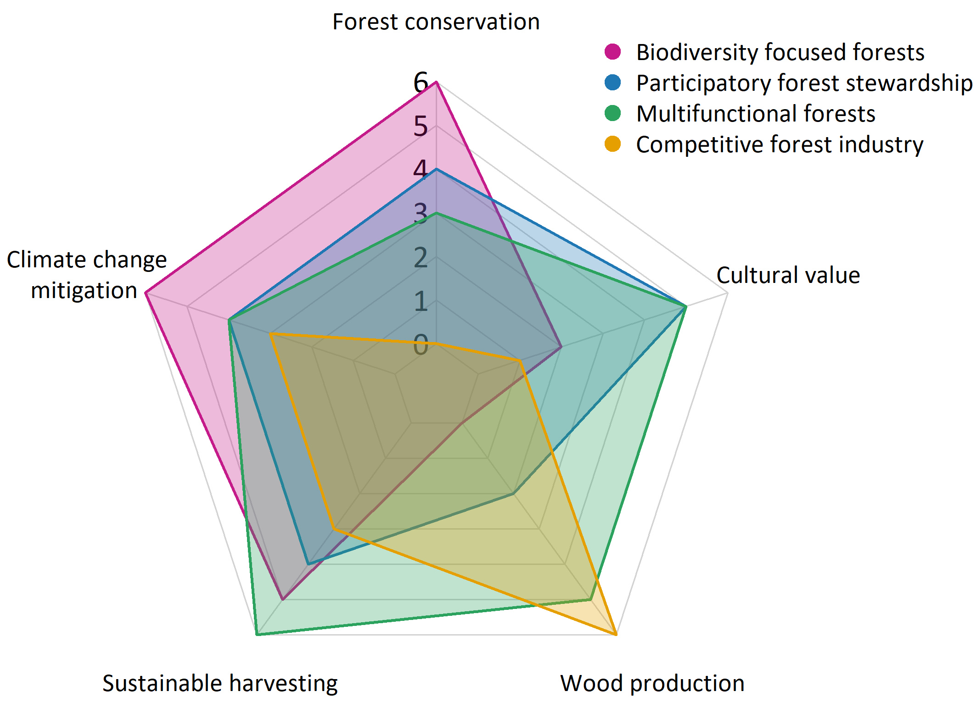
Forest management scenarios
Funded by the European Union. Views and opinions expressed are however those of the author(s) only and do not necessarily reflect those of the European Union or the European Climate, Infrastructure and Environment Executive Agency (CINEA). Neither the European Union nor the granting authority can be held responsible for them.
Notes:
Blank page slide for any use (more text, figures/charts, photos, etc.) - still mandatory to keep the logo, EC flag, and funding disclaimer

Slide 6
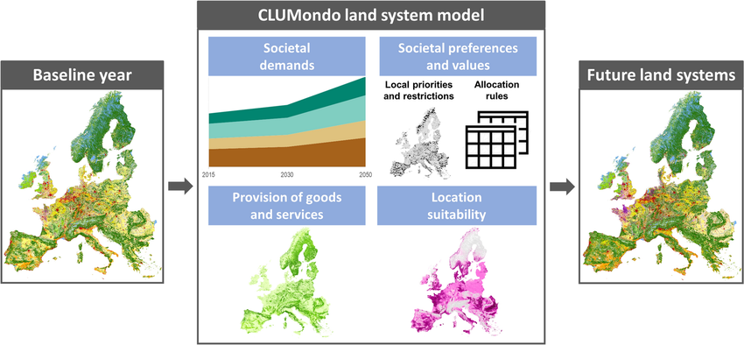
CLUMondo
Source: Diogo et al., 2025
Funded by the European Union. Views and opinions expressed are however those of the author(s) only and do not necessarily reflect those of the European Union or the European Climate, Infrastructure and Environment Executive Agency (CINEA). Neither the European Union nor the granting authority can be held responsible for them.
Notes:
Blank page slide for any use (more text, figures/charts, photos, etc.) - still mandatory to keep the logo, EC flag, and funding disclaimer

Slide 7
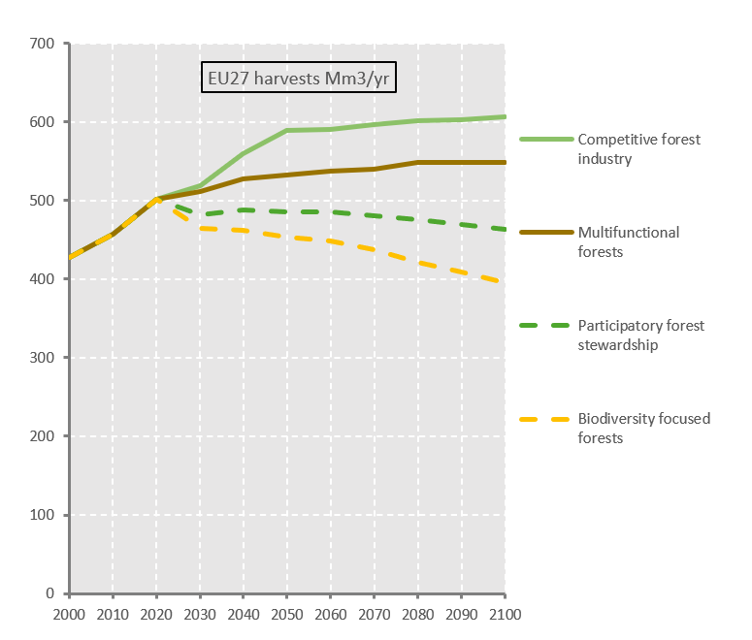
CLUMondo
Scenario | SSP-RCP | Bioenergy demand | PA | Connectivity weight | Innovation (%)
Biodiversity | 1-2.6 | Low | NfN | 0.6 | 0
PFS | 1-2.6 | Medium | NaC | 0.3 | 0
Multifunctional | 2-4.5 | Medium | NfS | 0.15 | 5
Competitive | 2-4.5 | High | Current | 0 | 10
Funded by the European Union. Views and opinions expressed are however those of the author(s) only and do not necessarily reflect those of the European Union or the European Climate, Infrastructure and Environment Executive Agency (CINEA). Neither the European Union nor the granting authority can be held responsible for them.
Notes:
Blank page slide for any use (more text, figures/charts, photos, etc.) - still mandatory to keep the logo, EC flag, and funding disclaimer

Slide 8
CLUMondo
2050
Funded by the European Union. Views and opinions expressed are however those of the author(s) only and do not necessarily reflect those of the European Union or the European Climate, Infrastructure and Environment Executive Agency (CINEA). Neither the European Union nor the granting authority can be held responsible for them.
Notes:
Blank page slide for any use (more text, figures/charts, photos, etc.) - still mandatory to keep the logo, EC flag, and funding disclaimer

Slide 9
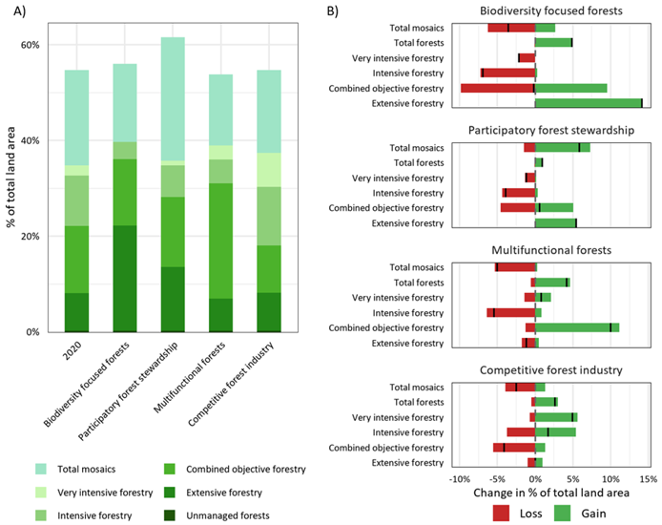
CLUMondo
2050
Funded by the European Union. Views and opinions expressed are however those of the author(s) only and do not necessarily reflect those of the European Union or the European Climate, Infrastructure and Environment Executive Agency (CINEA). Neither the European Union nor the granting authority can be held responsible for them.
Notes:
Blank page slide for any use (more text, figures/charts, photos, etc.) - still mandatory to keep the logo, EC flag, and funding disclaimer

Slide 10
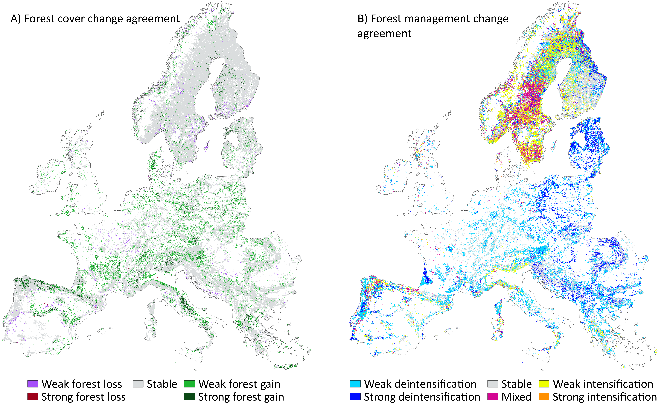
CLUMondo
Funded by the European Union. Views and opinions expressed are however those of the author(s) only and do not necessarily reflect those of the European Union or the European Climate, Infrastructure and Environment Executive Agency (CINEA). Neither the European Union nor the granting authority can be held responsible for them.
Notes:
Blank page slide for any use (more text, figures/charts, photos, etc.) - still mandatory to keep the logo, EC flag, and funding disclaimer

