Slide 1







Mapping & Estimation Platform
Presenters:
Mari Myllymäki¹, Jukka Miettinen², Ivo Kohn³ and Alessandro Cescatti⁴
¹Natural Resources Institute Finland, Finland, ²VTT Technical Research Centre of Finland, Finland, ³Czech Forestry Institute, Czechia, ⁴EC Joint Research Centre, Italy
PathFinder final conference
Brussels, 16 Jun 2026
Funded by the European Union. Views and opinions expressed are however those of the author(s) only and do not necessarily reflect those of the European Union or the European Climate, Infrastructure and Environment Executive Agency (CINEA). Neither the European Union nor the granting authority can be held responsible for them.
Notes:
Welcome slide

Slide 2

Outline
I
III
Overview
Estimation
Role of the mapping & estimation platform in the PathFinder approach
Cross-border harmonized estimates based on existing NFIs
II
IV
Mapping
EU policy support
European wide forest information in 10 m spatial resolution
Carbon farming baseline and forest area mapping
The research leading to these results has received funding from the European Union Horizon Europe (HORIZON) Research & Innovation programme under the Grant Agreement no. 101056907
Notes:
Outline slide

Slide 3
Overview
Role of the mapping & estimation platform in the PathFinder approach
The research leading to these results has received funding from the European Union Horizon Europe (HORIZON) Research & Innovation programme under the Grant Agreement no. 101056907
Notes:
Section title

Slide 4
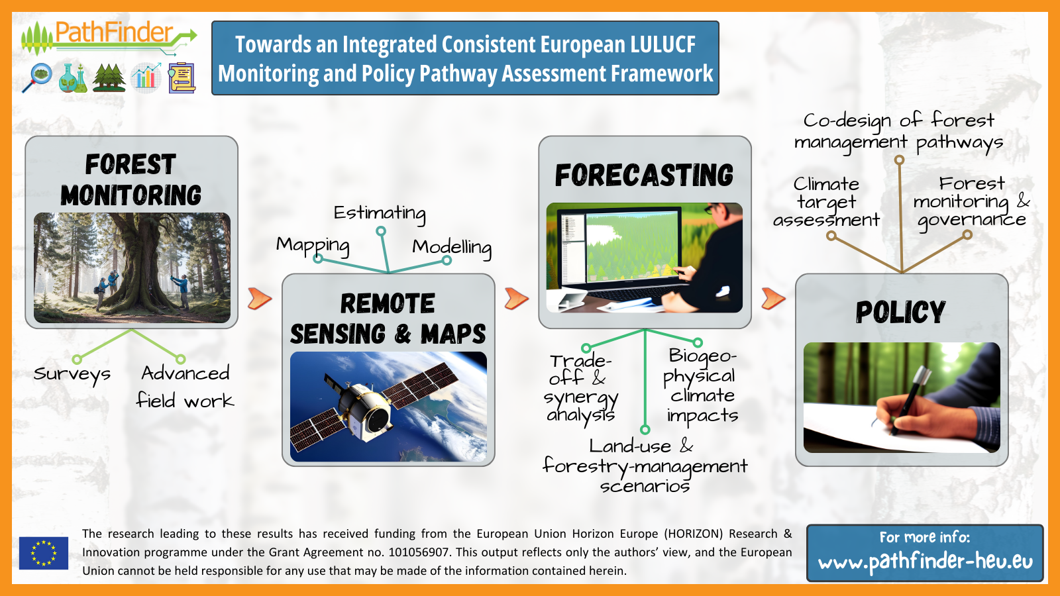

Slide 5

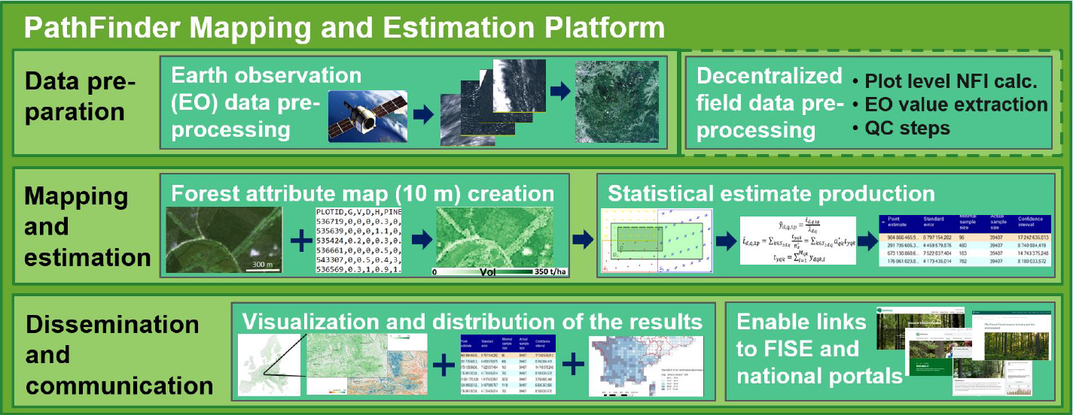
Integrated mapping and estimation concept
Full description in D2.1 at: https://pathfinder-heu.eu/resources
The research leading to these results has received funding from the European Union Horizon Europe (HORIZON) Research & Innovation programme under the Grant Agreement no. 101056907

Slide 6
Why is the integrated mapping and estimation important?
Benefits of the integrated mapping and estimation concept include:
      Maximising the benefits and potential of multisource data (including the long running National Forest Inventories)
      Controlled integration of EO based monitoring into existing reporting procedures
      Harmonized cross-border results throughout Europe
      Consistency of forest information from European to local levels
      Spatially explicit high resolution forest information to support CRCF and other key EU policies
The research leading to these results has received funding from the European Union Horizon Europe (HORIZON) Research & Innovation programme under the Grant Agreement no. 101056907

Slide 7
Mapping
European wide forest information in 10 m spatial resolution
The research leading to these results has received funding from the European Union Horizon Europe (HORIZON) Research & Innovation programme under the Grant Agreement no. 101056907
Notes:
Section title

Slide 8
Mapping specifications in the platform demonstration
Satellite data:
Sentinel-2 composite (10 m)
Year 2020 (+2024, 4 layers)
Reference data:
NFI plots, 6-14 countries, depending on the variable
Auxiliary features used:
Copernicus 30 m DEM
CLMS layers
Chelsa (~1 km, 1981-2010): climatic data
Maryland tree cover change product
Variables mapped:
Growing Stock Volume
Above Ground Biomass
Conifer proportion (of biomass)
Species proportions (of biomass): -->
Diameter (quadratic mean)
Basal area
Height
Gross annual increment (of biomass)
Net annual increment (of biomass)
Deadwood
1. Betula + Carpinus + Fraxinus
2. Populus and Salix
3. Fagus
4. Quercus
5. Eucalyptus
6. Other_Broadleaf
7. Picea
8. Abies
9. Pinus
10. Other Conifers
Funded by the European Union. Views and opinions expressed are however those of the author(s) only and do not necessarily reflect those of the European Union or the European Climate, Infrastructure and Environment Executive Agency (CINEA). Neither the European Union nor the granting authority can be held responsible for them.

Slide 9
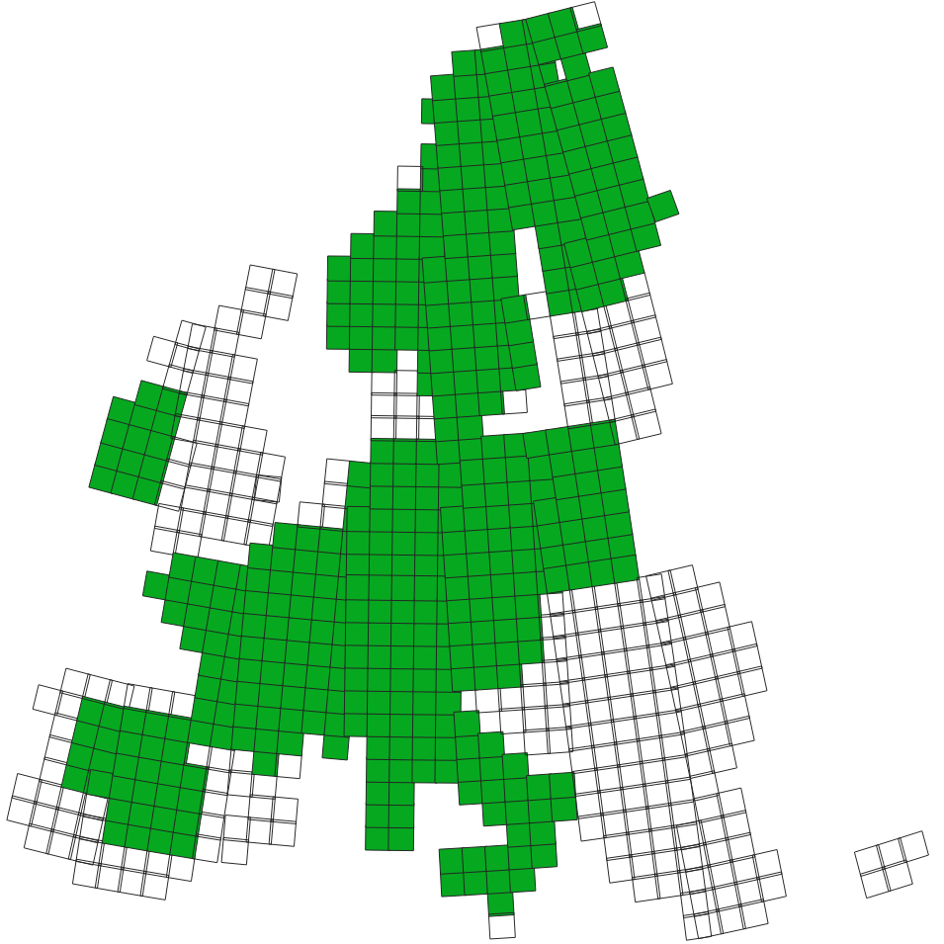
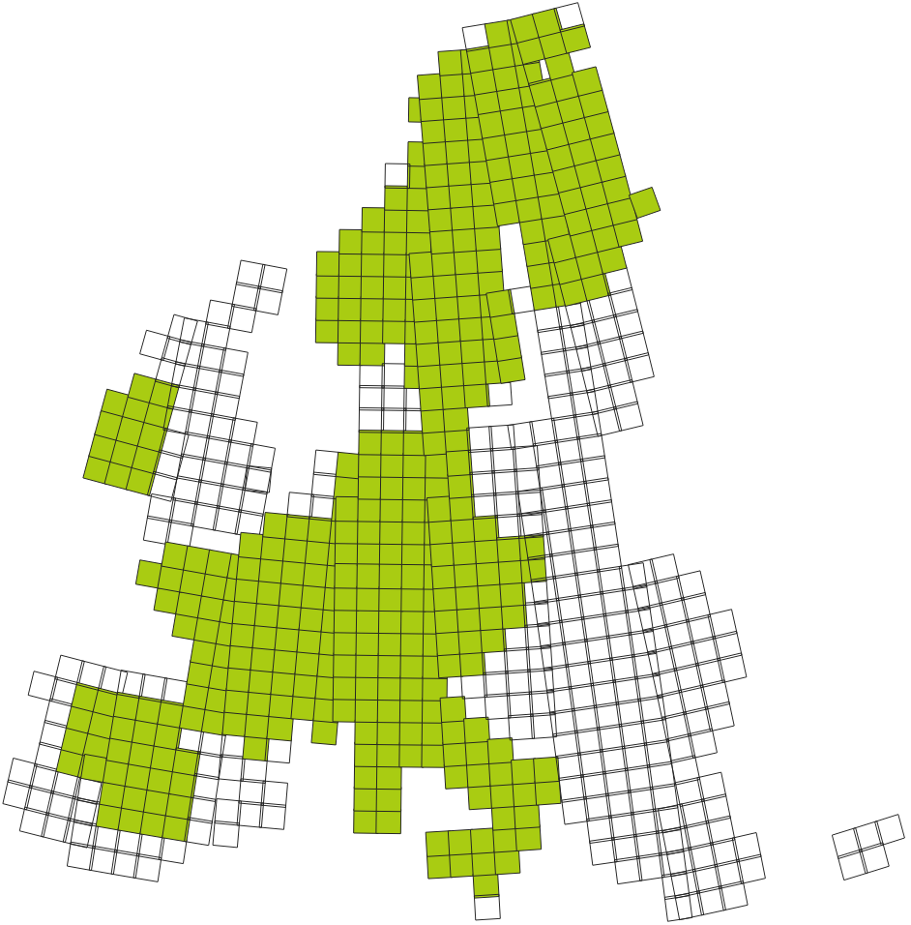
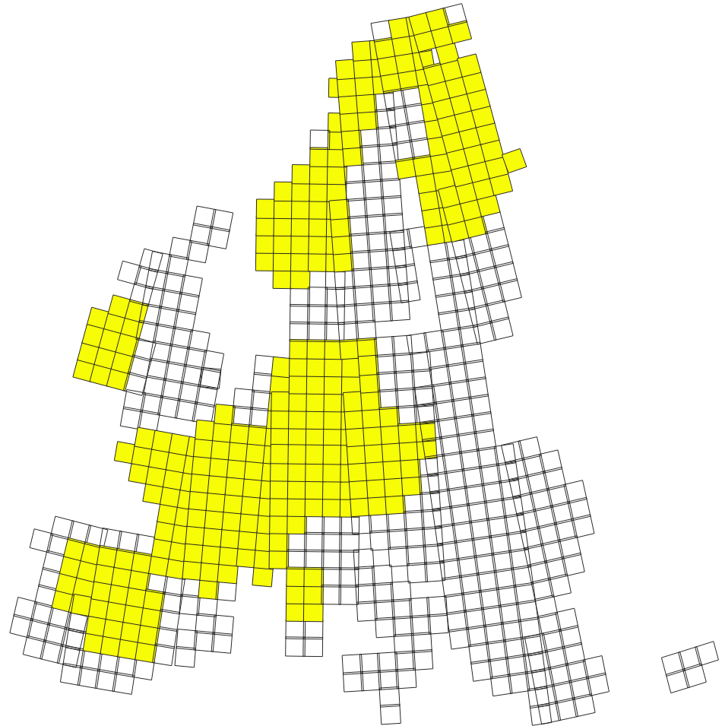
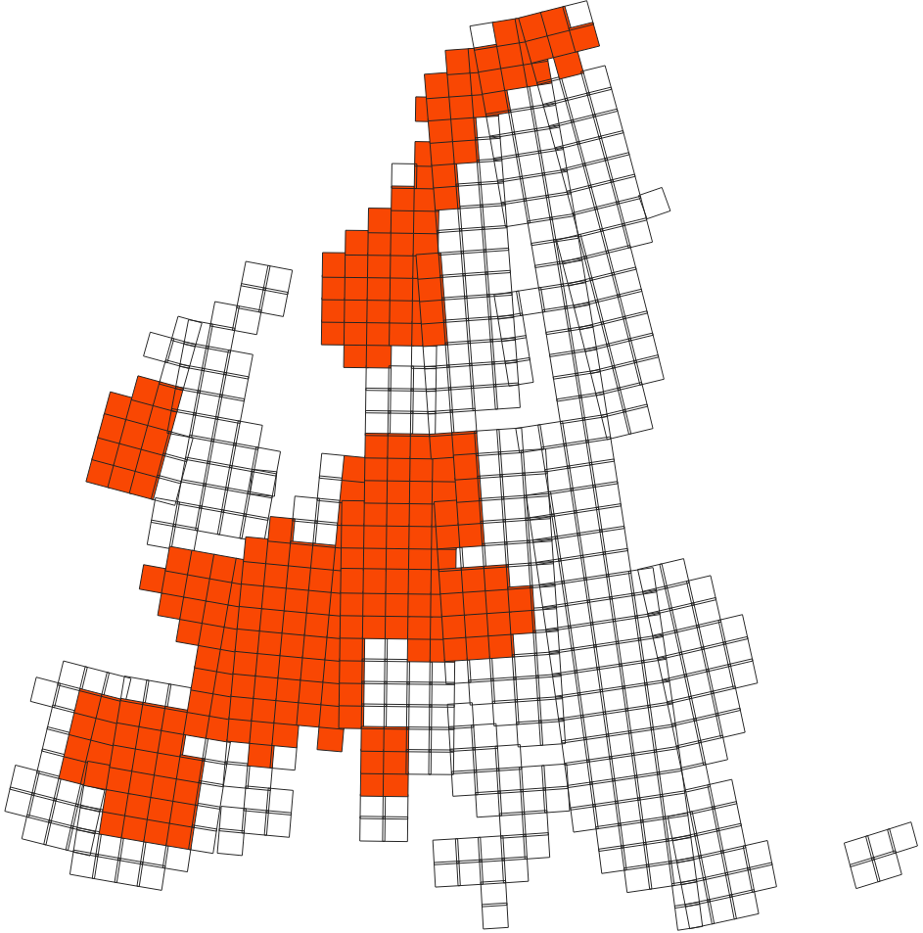
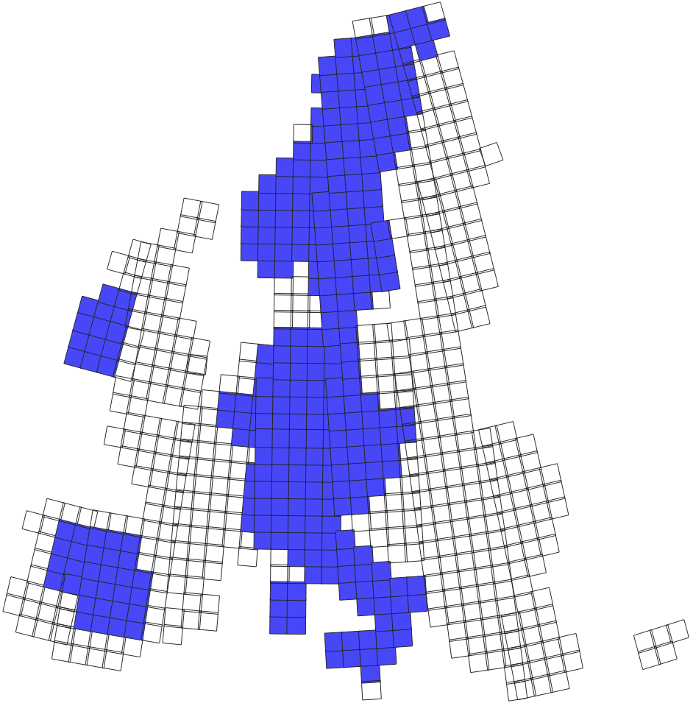
NFI field plot availability by attributes
FB1 (13 attributes)
119 398 plots
FB2 (diameter)
94 924 plots
FB3 (basal area)
69 552 plots
FB5 (GAI, NAI)
45 387 plots
FB4 (height)
45 361 plots
Funded by the European Union. Views and opinions expressed are however those of the author(s) only and do not necessarily reflect those of the European Union or the European Climate, Infrastructure and Environment Executive Agency (CINEA). Neither the European Union nor the granting authority can be held responsible for them.

Slide 10
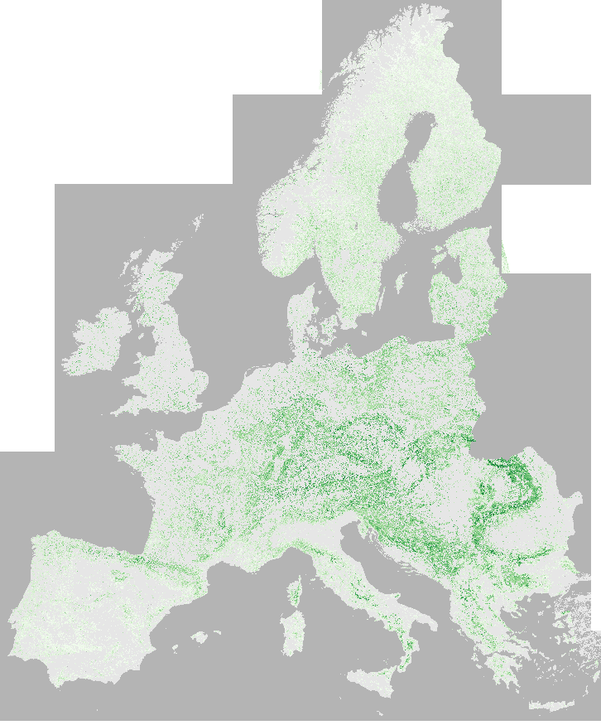
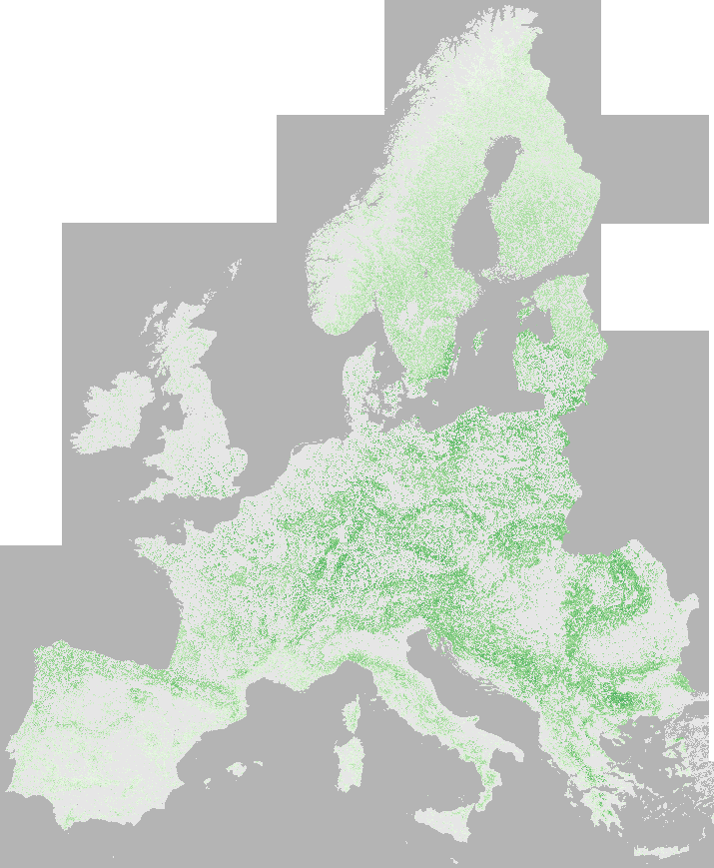
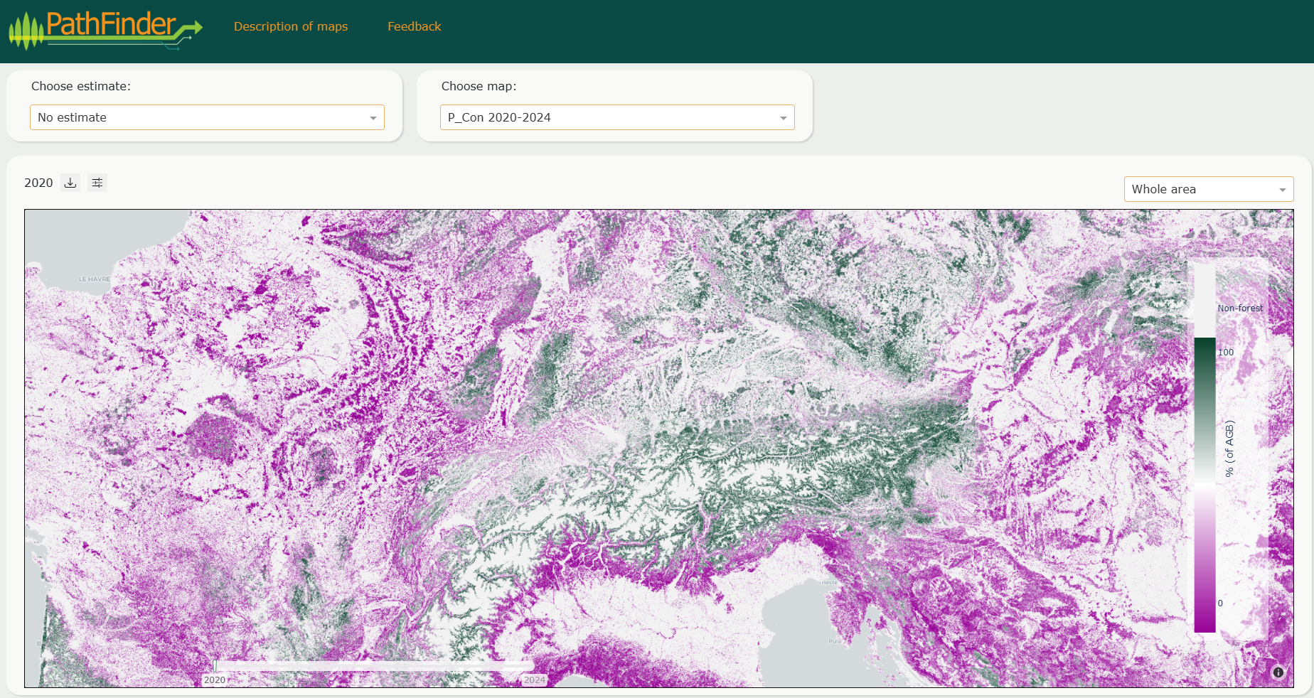
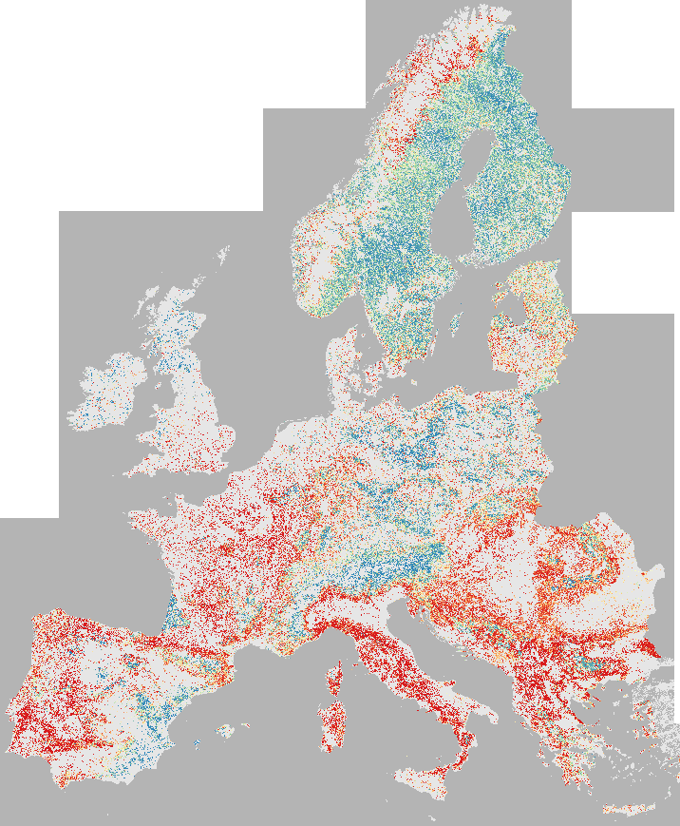
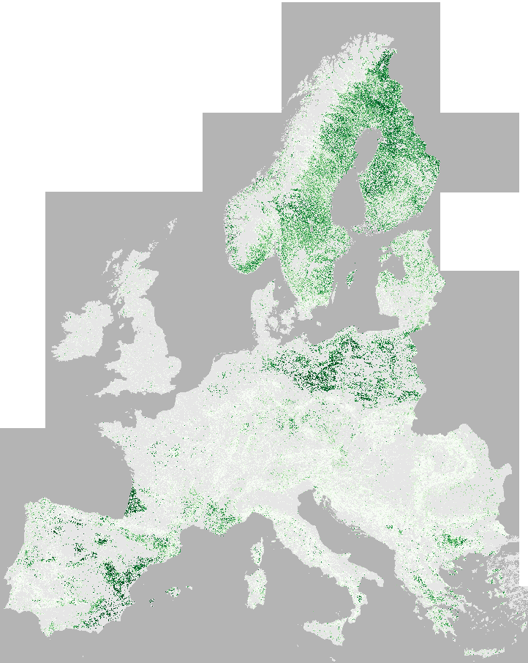
Maps are publicly available
Live demo coming soon…
0 AGB (t/ha) 450
0 H (dm) 500
AGB
Visualization and download portal at: https://portal.pathfinder-heu.eu/
Height
0 Conifer % 100
0 % 100
Con%
Pinus
Notes:
Text slide (v.1)

Slide 11
Map accuracy I
Error metrics calculated from all NFI plots
Variable | RMSE | RMSE% | Bias | Bias% | R²
Growing Stock Volume | 137.78 | 69.53 | 1.57 | 0.79 | 0.42
Above Ground Biomass | 85.58 | 67.45 | 0.82 | 0.64 | 0.36
Conifer proportion (of AGB) | 23.90 | 43.00 | 0.48 | 0.86 | 0.69
Quadratic mean diameter | 9.43 | 45.34 | -0.09 | -0.43 | 0.31
Basal area | 12.11 | 53.85 | 0.06 | 0.27 | 0.37
Height | 49.31 | 31.23 | 0.19 | 0.12 | 0.63
Betula + Carpinus + Fraxinus | 20.57 | 157.51 | -0.25 | -1.94 | 0.30
Populus and Salix | 11.75 | 459.33 | -0.37 | -14.62 | 0.13
Fagus | 15.11 | 256.98 | -0.02 | -0.37 | 0.41
Quercus | 21.01 | 140.10 | 0.55 | 3.65 | 0.56
Eucalyptus | 1.76 | 3234.64 | -0.01 | -12.85 | 0.37
Other_broadleaf | 18.85 | 239.76 | -0.37 | -4.71 | 0.22
Picea | 22.00 | 114.39 | -0.60 | -3.14 | 0.54
Abies | 8.06 | 484.82 | -0.06 | -3.68 | 0.37
Pinus | 25.58 | 78.72 | 1.20 | 3.69 | 0.61
Other conifers | 10.50 | 478.32 | -0.05 | -2.47 | 0.23
RMSE and R² levels allow operational forest monitoring (in combination with field plots!).
Bias is very small – one of the benefits of k-NN method.
For tree species, these error metrics provide little information due to the drastically varying (and often low) proportions of the species in a given area.
Density scatter plots recommended as the most informative source of error information for the species proportion maps.
Funded by the European Union. Views and opinions expressed are however those of the author(s) only and do not necessarily reflect those of the European Union or the European Climate, Infrastructure and Environment Executive Agency (CINEA). Neither the European Union nor the granting authority can be held responsible for them.

Slide 12
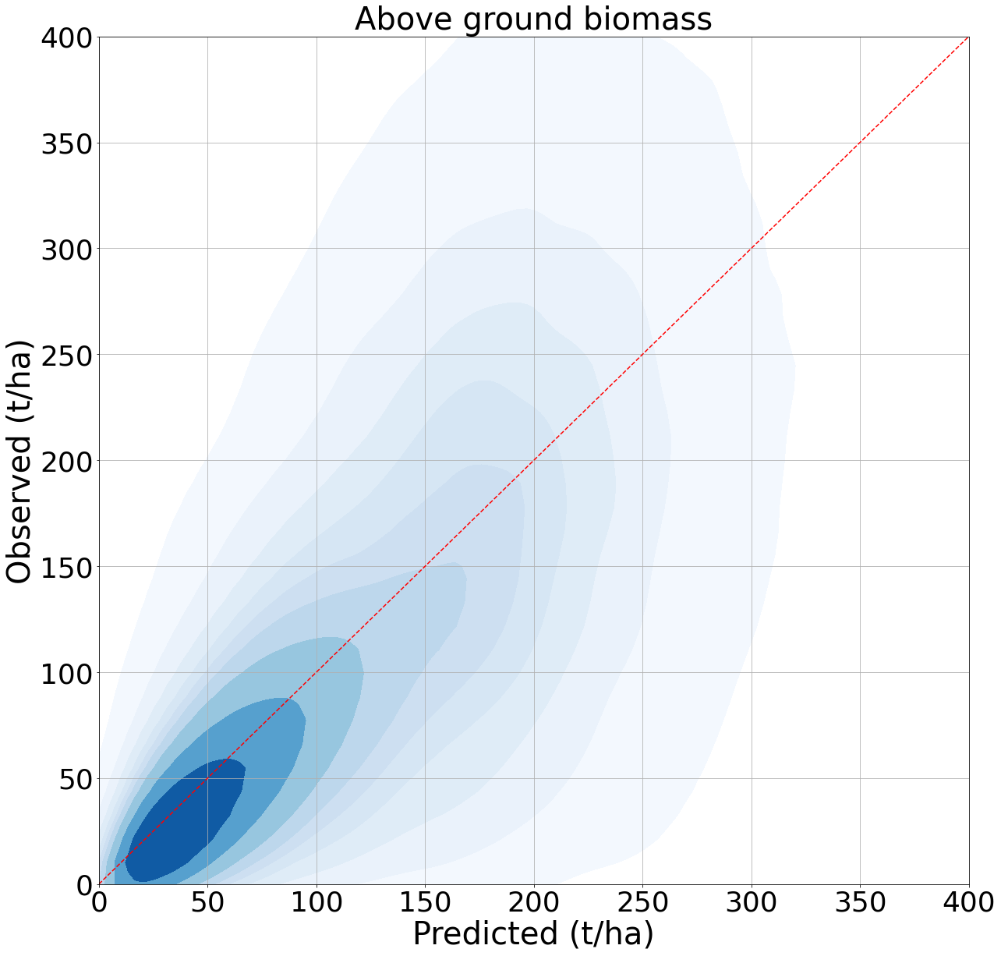
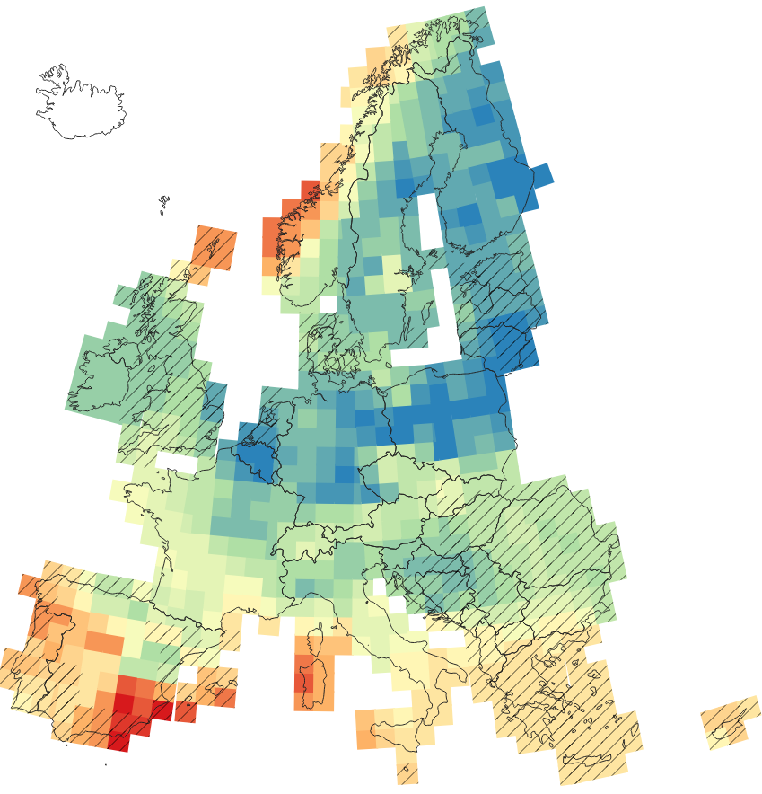
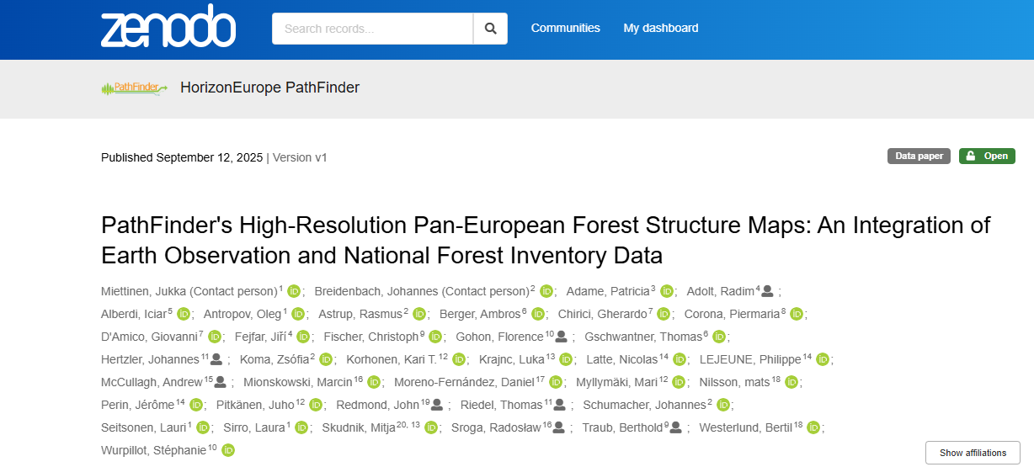
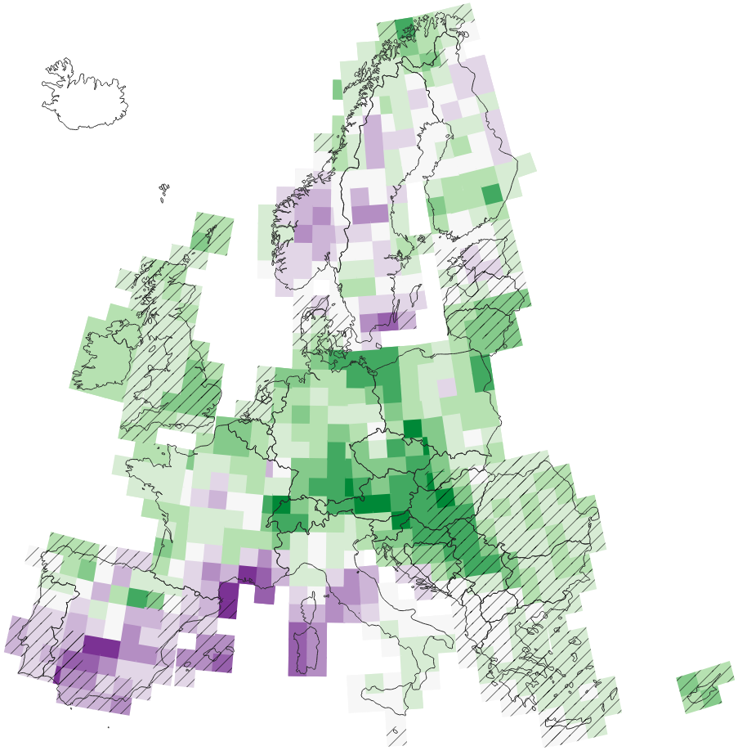
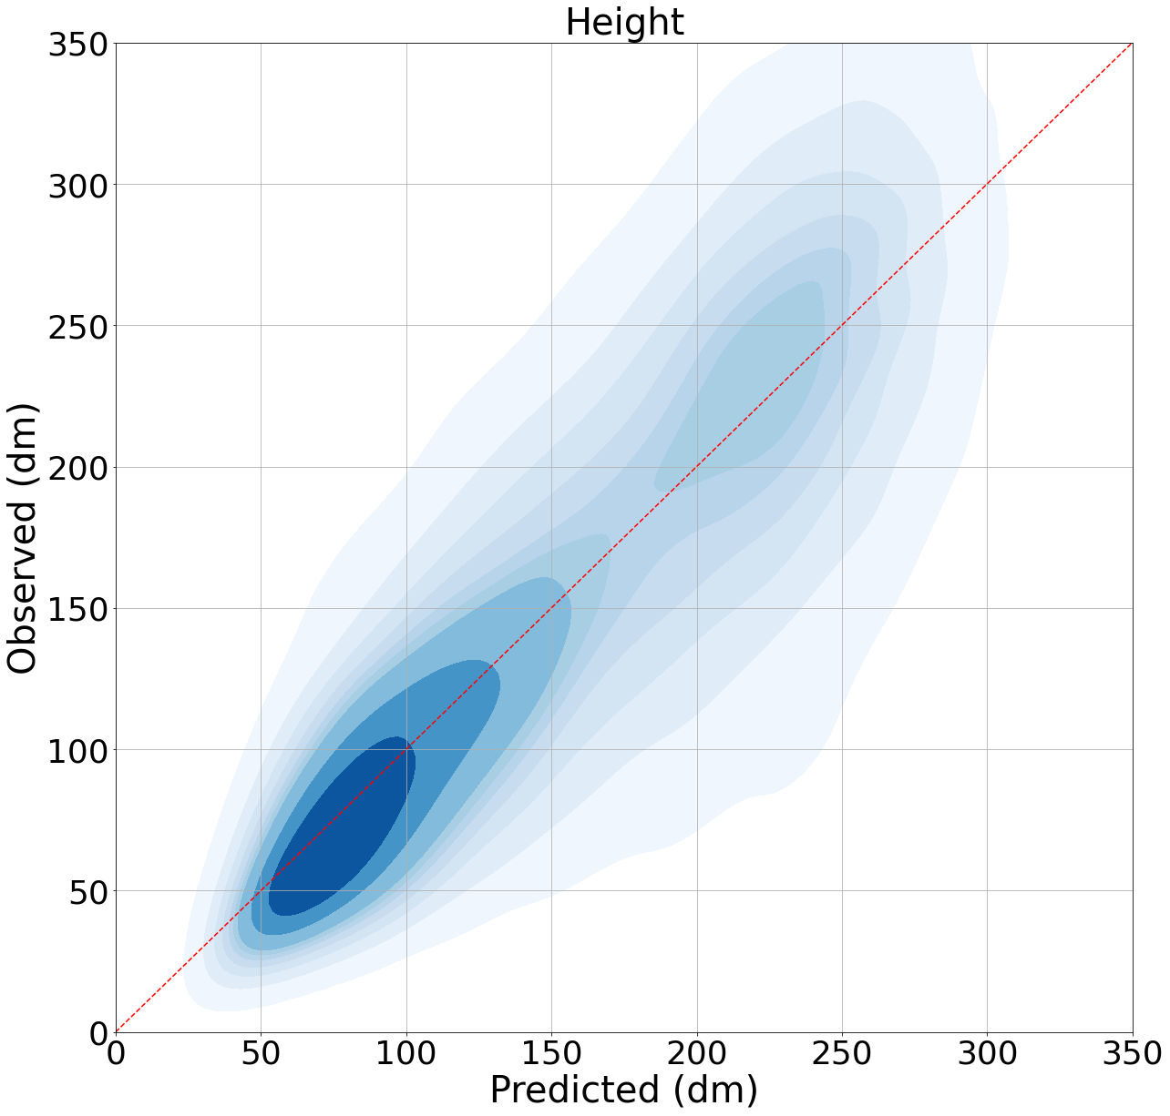
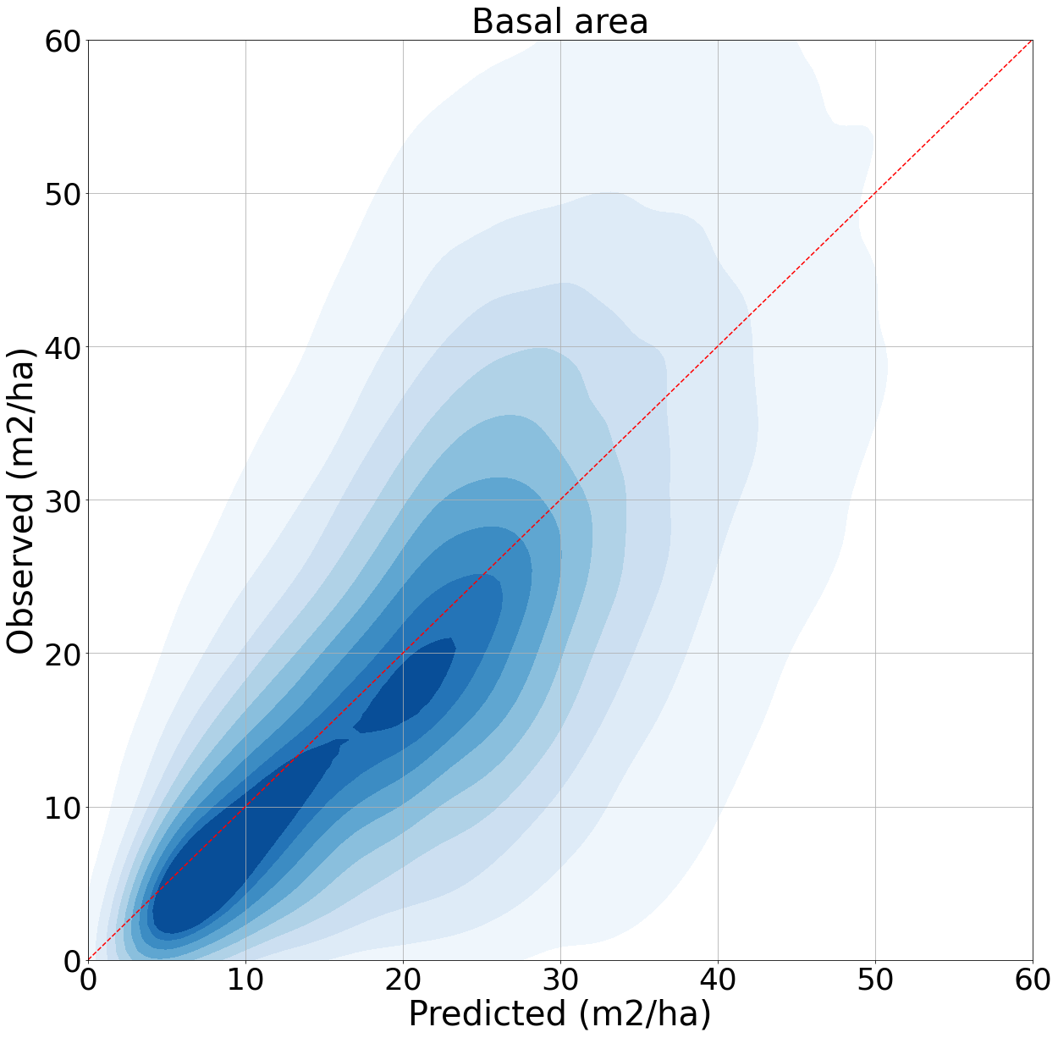
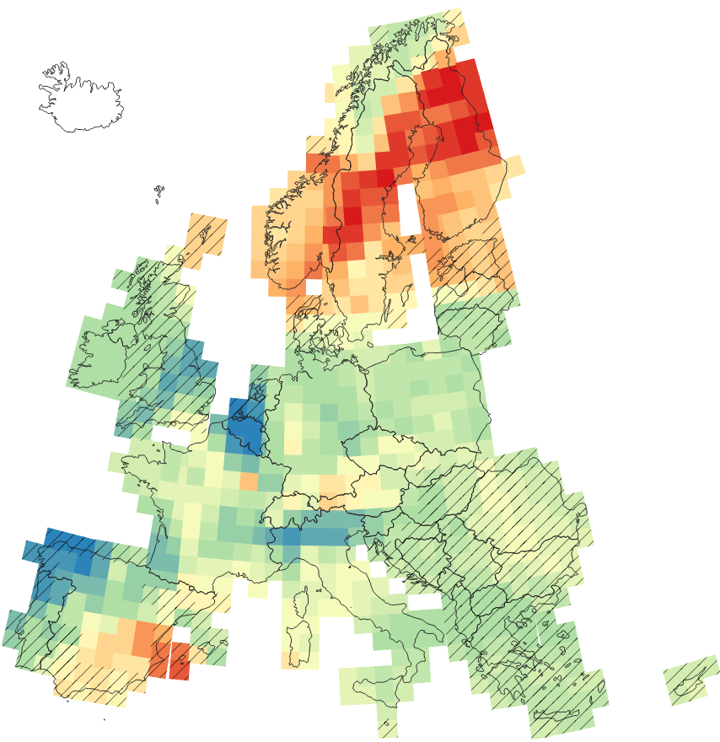
Map accuracy II
Full accuracy details at:
https://doi.org/10.5281/zenodo.17107267
AGB RMSE%
50 % 90
Vol bias%
Con% R²
-6 % 5
0.22 0.85
Areas without plots hashed
Funded by the European Union. Views and opinions expressed are however those of the author(s) only and do not necessarily reflect those of the European Union or the European Climate, Infrastructure and Environment Executive Agency (CINEA). Neither the European Union nor the granting authority can be held responsible for them.

Slide 13
Estimation
Cross-border harmonized estimates based on existing NFIs
The research leading to these results has received funding from the European Union Horizon Europe (HORIZON) Research & Innovation programme under the Grant Agreement no. 101056907
Notes:
Section title

Slide 14
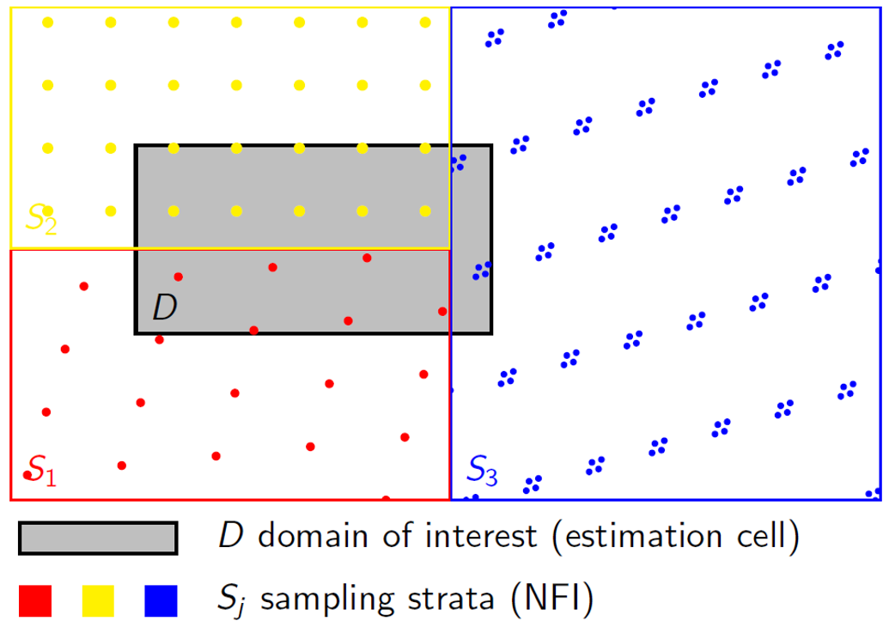
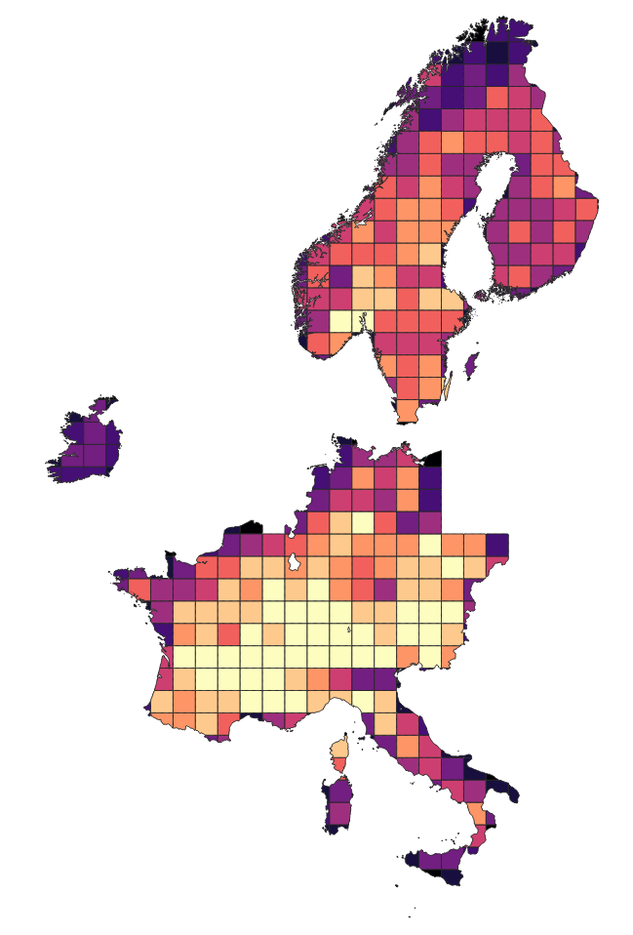
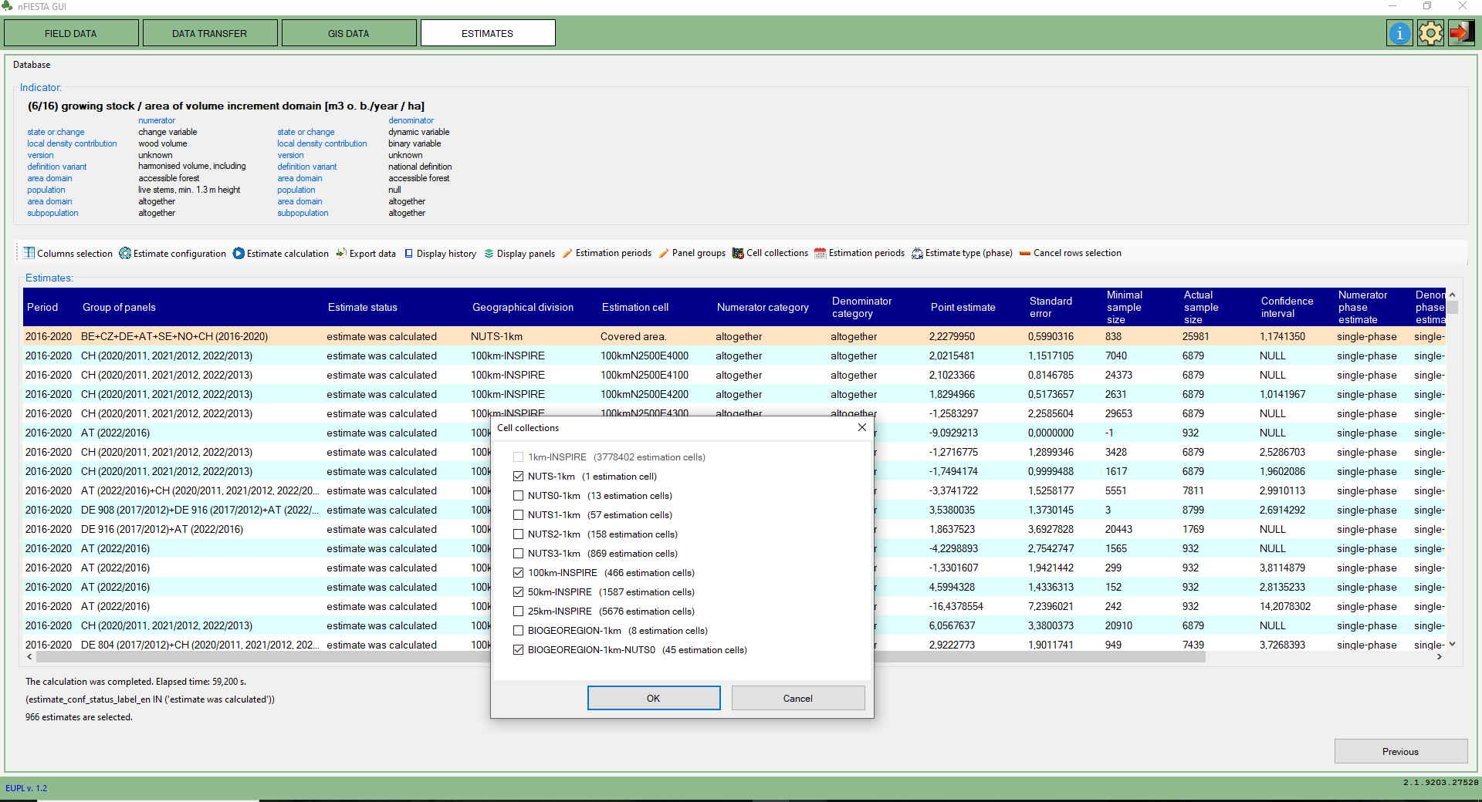
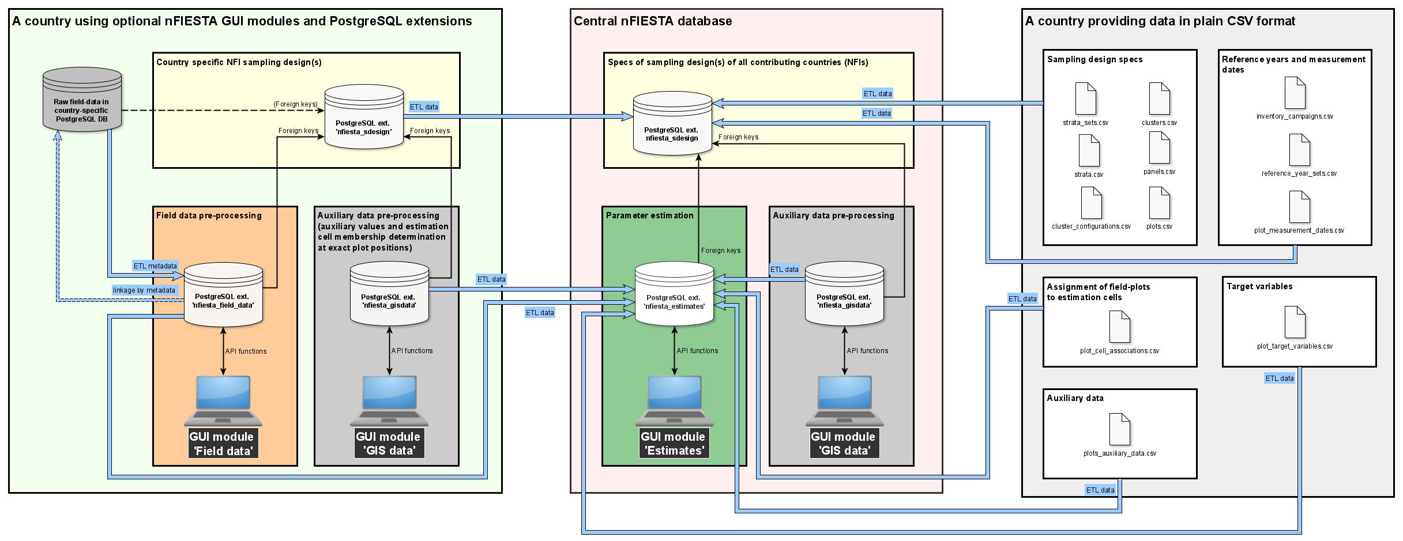
Estimates nFIESTA = new Forest Inventory, Estimation and Analysis framework
Developed by Radim Adolt et al. at Czech Forestry Institute (NLI) in DIABOLO, PathFinder and Monifun EU projects (nFIESTA · GitLab).
Implements NFI best practices of producing forest related information for strategic planning and policy formulation.
Statistically-sound estimates for probability samples, typically NFI data, which may come from two or more countries using a different sampling designs.
Model based-estimates in areas with missing or insufficient field-plot data.
Funded by the European Union. Views and opinions expressed are however those of the author(s) only and do not necessarily reflect those of the European Union or the European Climate, Infrastructure and Environment Executive Agency (CINEA). Neither the European Union nor the granting authority can be held responsible for them.

Slide 15
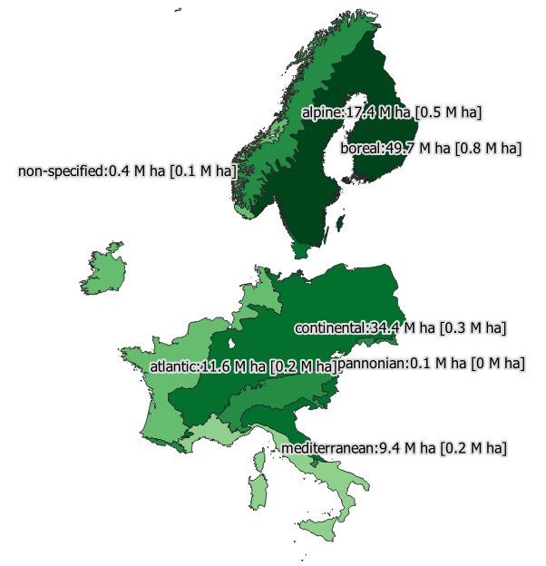
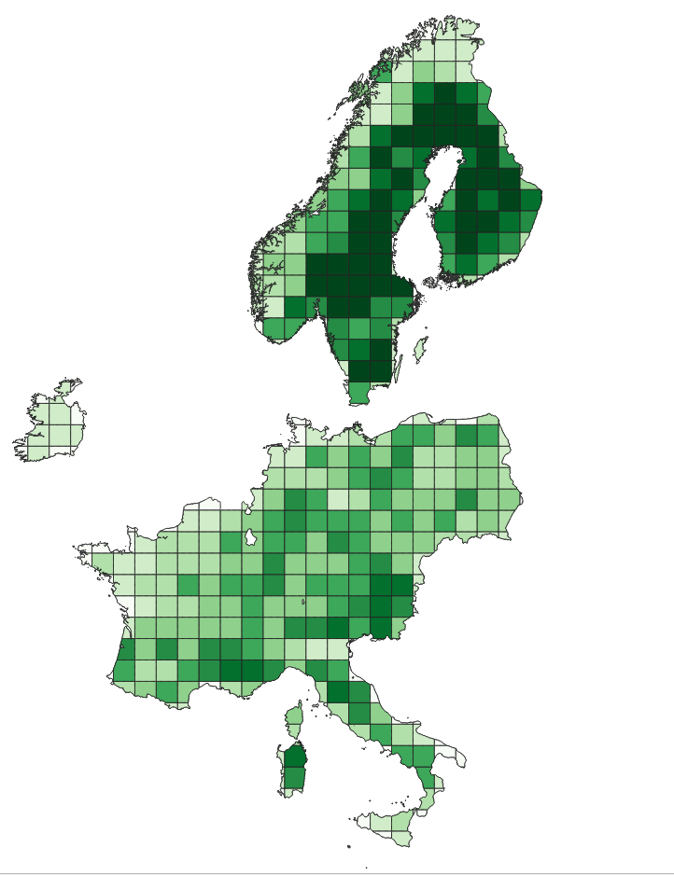
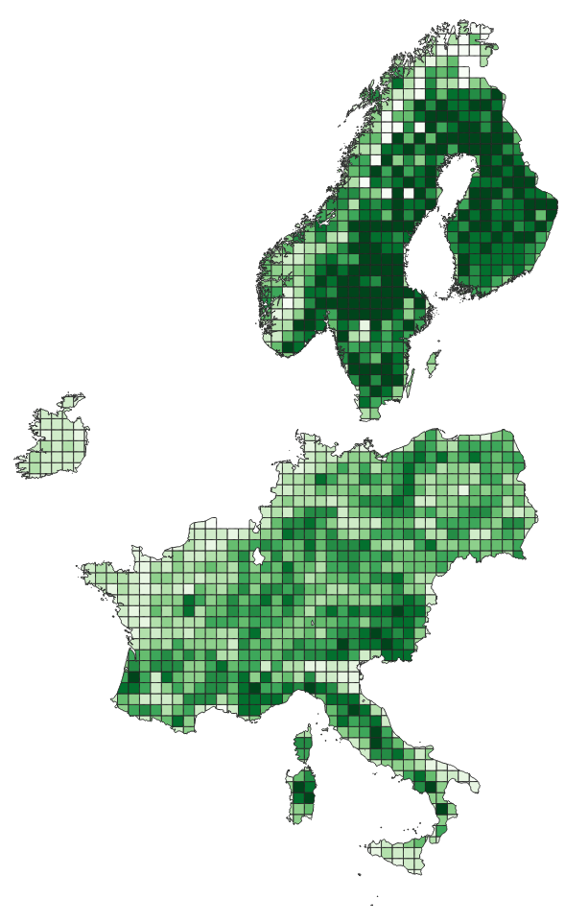
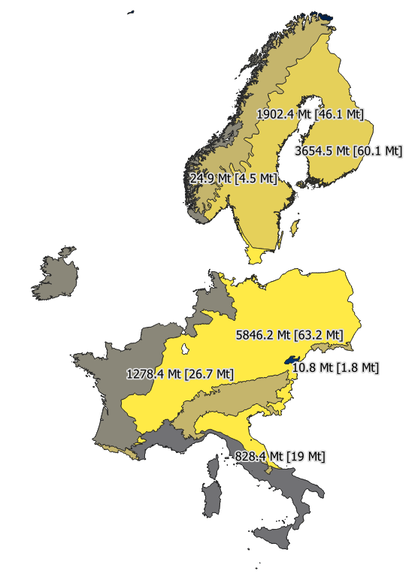
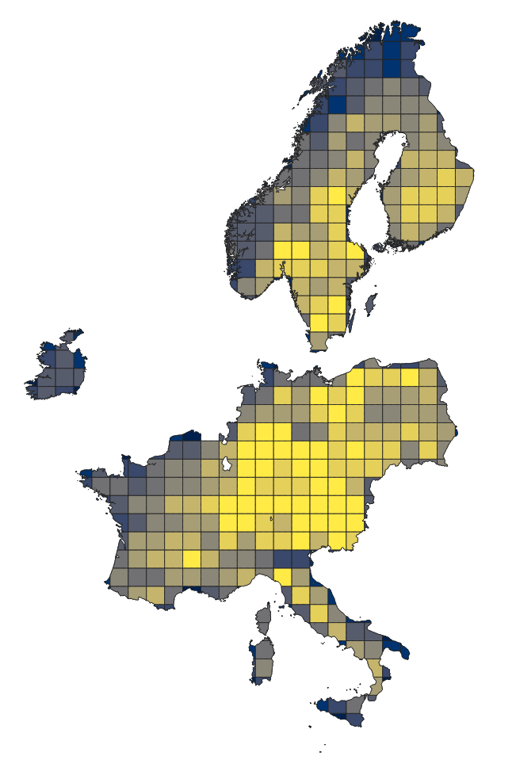
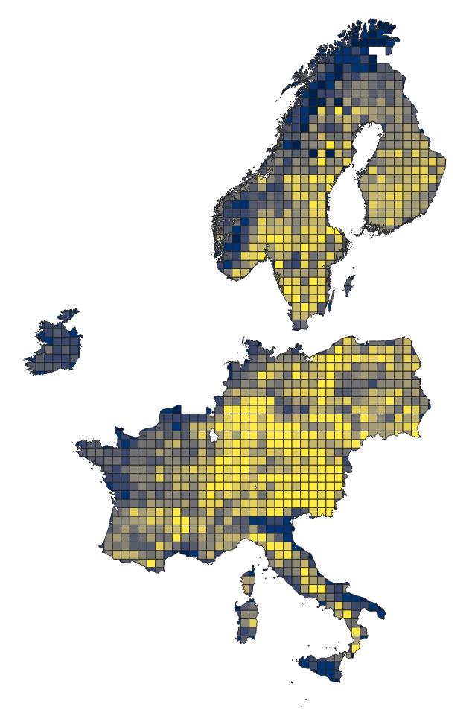
Design based estimation
Harmonized estimates across Europe derived from NFI datasets for:
Total area
Biogeographical regions
INSPIRE cells in various levels (100 km, 50 km…)
Arbitrary interest areas
Forest area
Biogeographical regions
INSPIRE 100x100 km
INSPIRE 50x50 km
Above ground biomass
Funded by the European Union. Views and opinions expressed are however those of the author(s) only and do not necessarily reflect those of the European Union or the European Climate, Infrastructure and Environment Executive Agency (CINEA). Neither the European Union nor the granting authority can be held responsible for them.

Slide 16
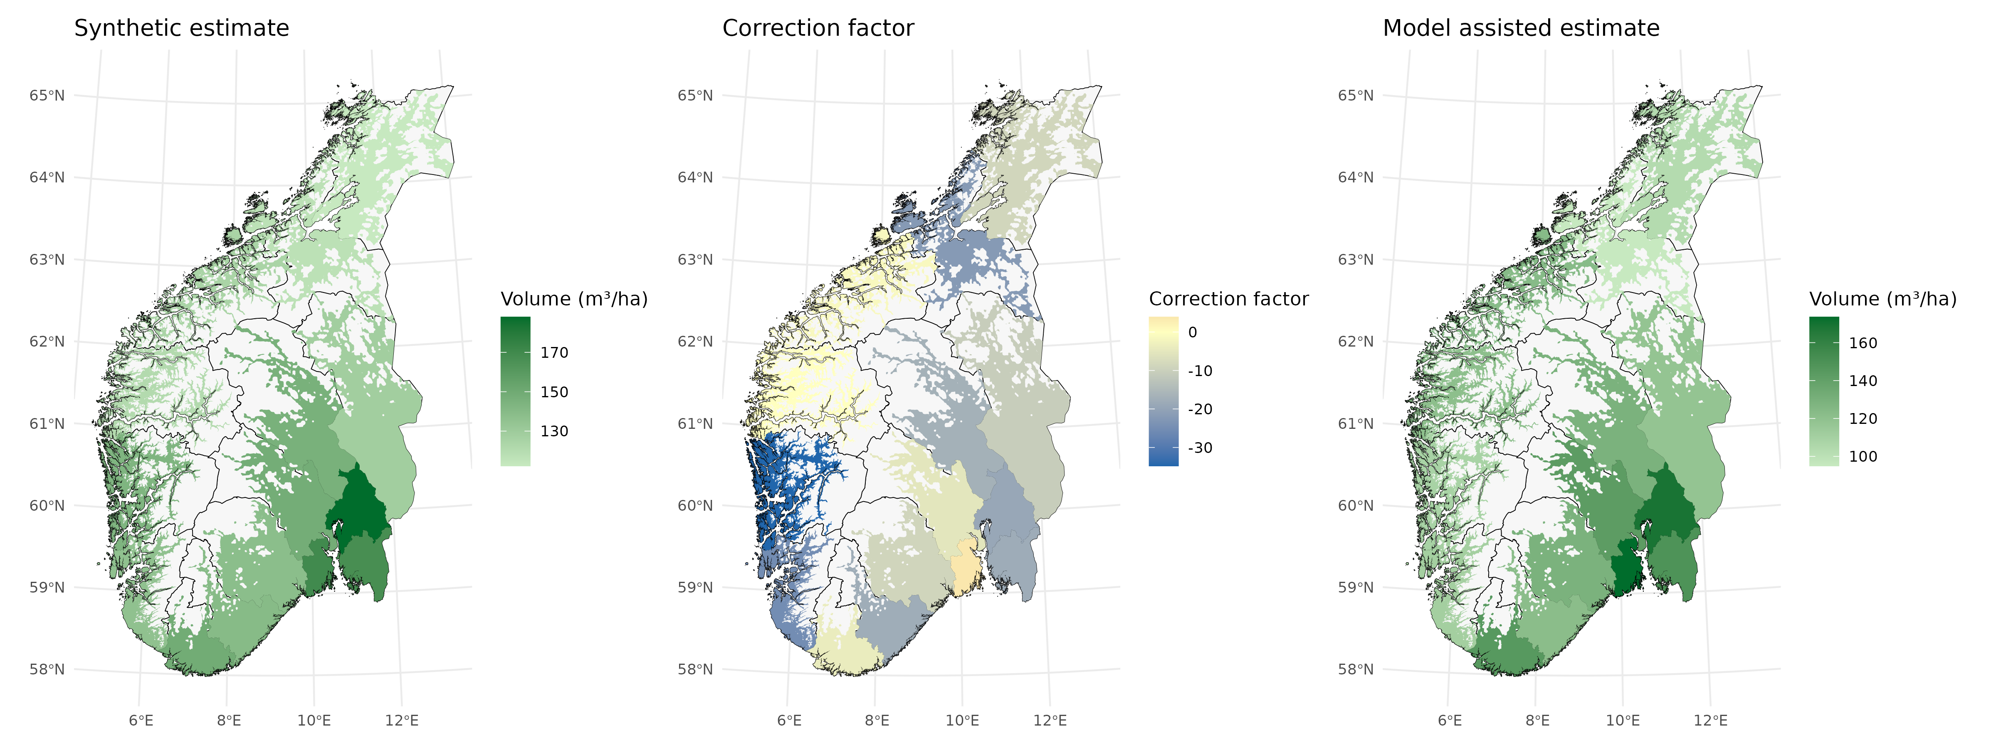
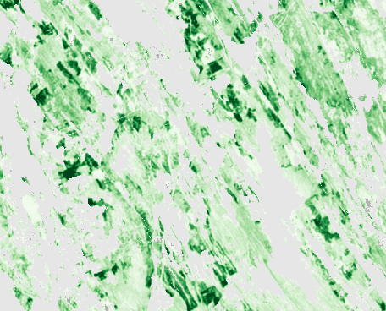
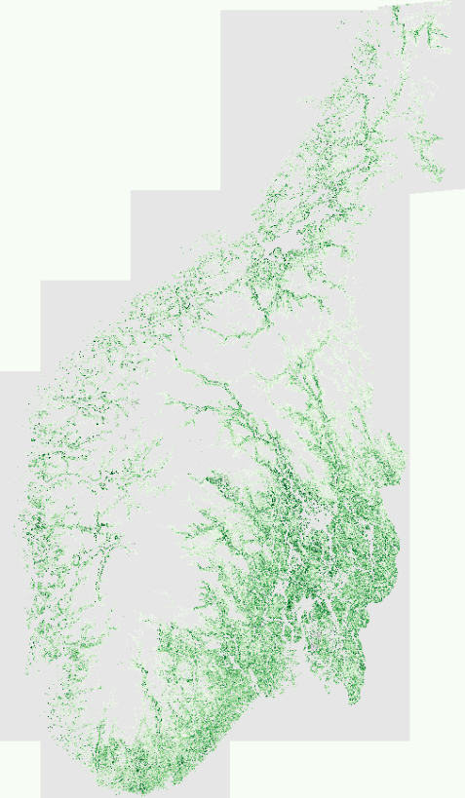
Consistent forest information across all levels
European to national level
Provincial to municipality level
Model assisted estimation
(NFI and maps combined)
Design based estimation (field plots)
Local level
Key points:
All information based on the same input datasets: --> Consistency across levels
Enables integration of EO based mapping into existing reporting procedures
Reduces standard error for small areas
Provides fine-scale (10 m) information on relative distribution of forests on local level
Maps showing distribution in high detail
7 x 7 km

Slide 17
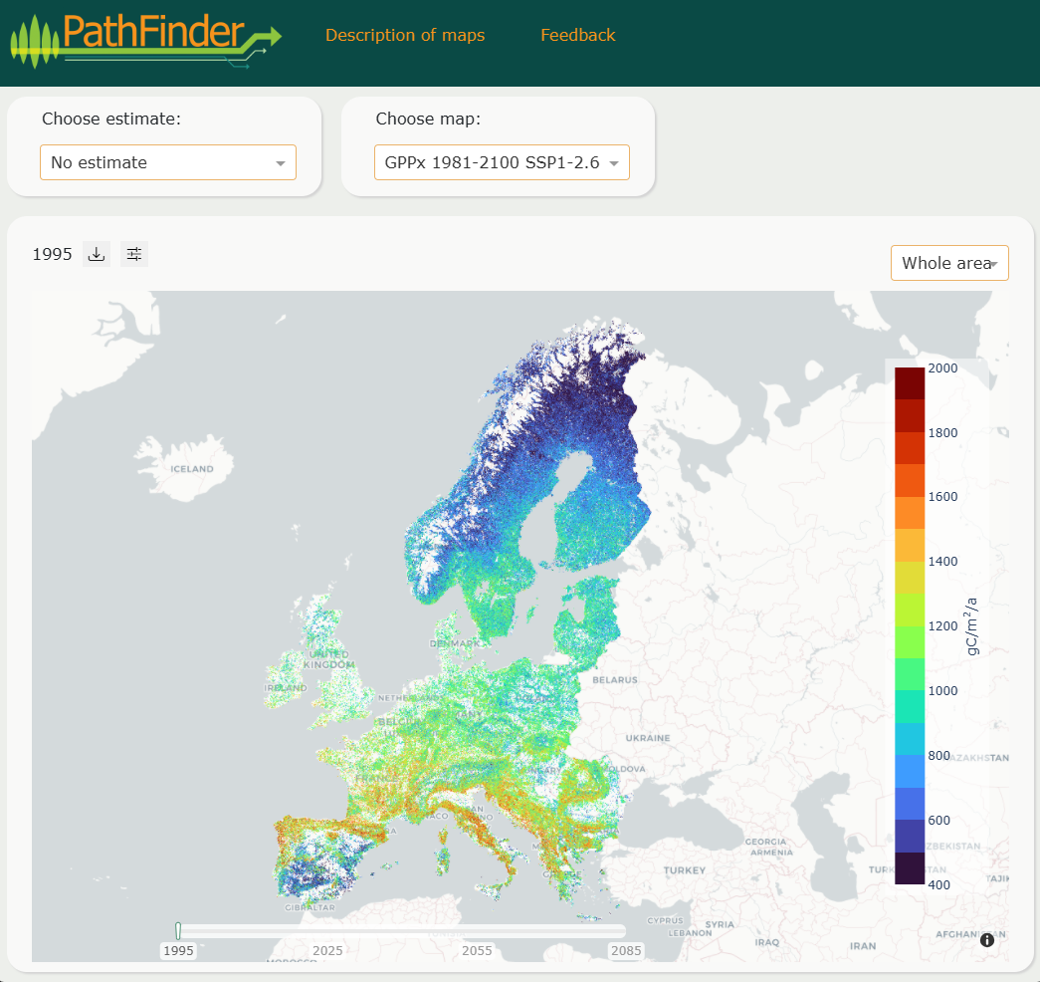
PathFinder portal
Where:
  https://portal.pathfinder-heu.eu/
What:
    Maps
      Forest attribute maps (x 18+3)
      Deadwood map
    Estimates
      Single phase estimates
      Model assisted estimates
    Forecasts
      GPPx forecasts (x 2) à 2100
      CLUMondo scenario forecasts (x 4) à 2100
      PixSim forecasts à 2100
Why:
  Visualization, download and links to sources.
Coming soon…
Coming soon…
Funded by the European Union. Views and opinions expressed are however those of the author(s) only and do not necessarily reflect those of the European Union or the European Climate, Infrastructure and Environment Executive Agency (CINEA). Neither the European Union nor the granting authority can be held responsible for them.

Slide 18
EU Policy Support
• Carbon farming baseline
• Forest area mapping
The research leading to these results has received funding from the European Union Horizon Europe (HORIZON) Research & Innovation programme under the Grant Agreement no. 101056907
Notes:
Section title

Slide 19
EU policy support - Objectives
Supporting the EU Carbon Removals and Carbon Farming Regulation (CRCF, EU 2024/3012) and the Forest Monitoring Law (FML) proposal
CRCF: develop MRV tools for the calculation of the standardized baseline and mapping net and gross annual increments of European forests
FML: develop and validate a map of forest area as Land Use: validation of a European forest area map using National Forest Inventory (NFI) data
Funded by the European Union. Views and opinions expressed are however those of the author(s) only and do not necessarily reflect those of the European Union or the European Climate, Infrastructure and Environment Executive Agency (CINEA). Neither the European Union nor the granting authority can be held responsible for them.

Slide 20
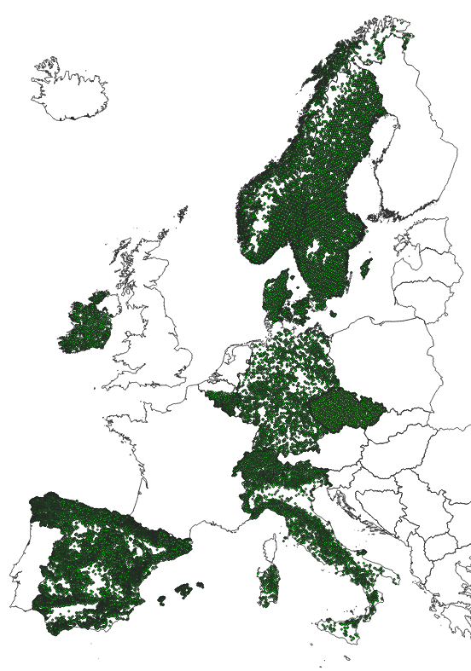
Carbon farming baseline - Overview
Input data
NFI plots
  10 countries - 78,000 plots
Maps
  73 predictors
Modelling approach
  Data driven (Decision trees, Xgboost)
  1 country = 1 model
Aim
  Net Annual Increment
  Proxy of carbon removal
  Business-as-usual scenario
NFI plots
Variables
NFI Plots | Maps
Forest Type | Sentinel-2
Tree Diameter | Forest Type
Biomass Species | Forest Loss Tree Cover
Interventions | Tree Diameter
 | Tree Height
 | Biomass
 | Main Species
 | Biodiversity index
 | Productivity index
 | Disturbances
 | Management
 | Climate variables
 | Soil properties
 | Elevation & Slope
Funded by the European Union. Views and opinions expressed are however those of the author(s) only and do not necessarily reflect those of the European Union or the European Climate, Infrastructure and Environment Executive Agency (CINEA). Neither the European Union nor the granting authority can be held responsible for them.
Notes:
For 4 maps (Sentinel-2, Forest type, Forest loss and Tree Cover) we had the map values in correspondence of the exact plot location (data extracted by the NFIs), for all other maps we used the 1-Km approximate plot geolocation and computed the mean value of the maps within the 1 Km INSPIRE grid cell

Slide 21
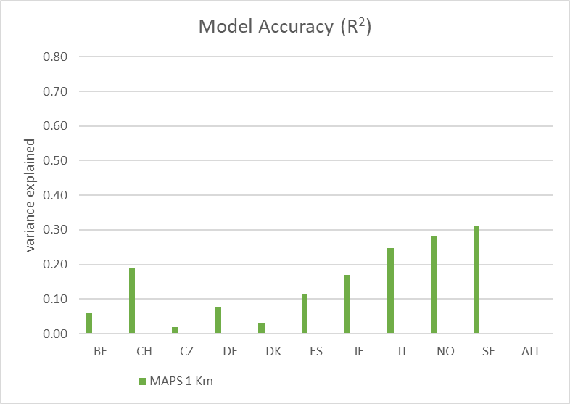
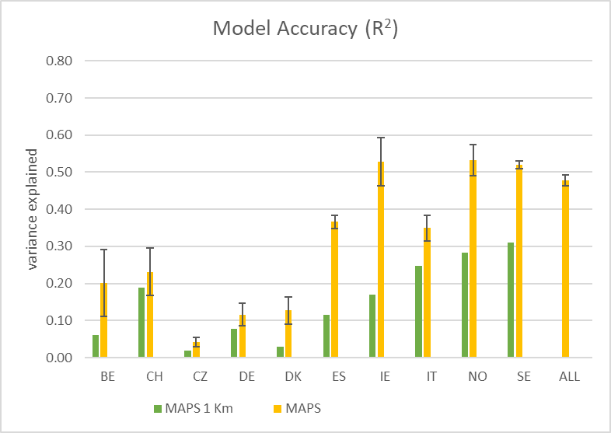
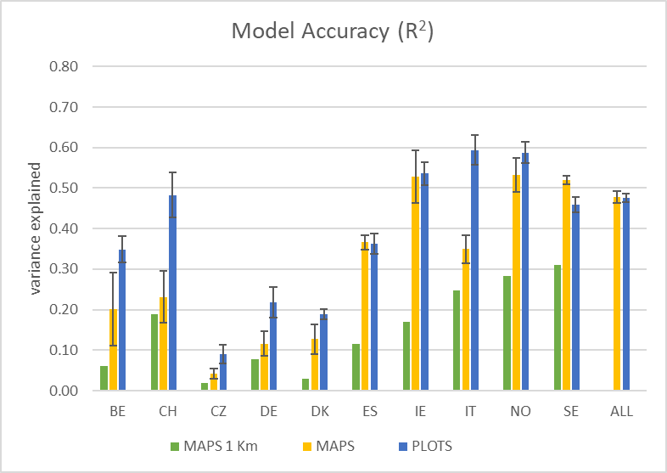
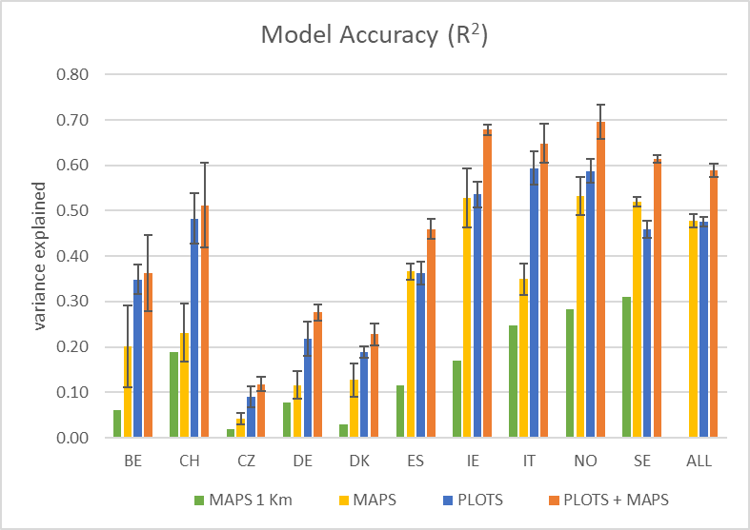
Carbon farming baseline - Results
Variable to predict
  Net Annual Increment
Predictors
  PLOTS: only NFI field variables
  MAPS: only satellite-based variables
  PLOTS + MAPS: field + satellite variables
Results
  Accuracy varies by country
  Relevance of map - plot colocation
  Integration PLOTS + MAPS = best results
Funded by the European Union. Views and opinions expressed are however those of the author(s) only and do not necessarily reflect those of the European Union or the European Climate, Infrastructure and Environment Executive Agency (CINEA). Neither the European Union nor the granting authority can be held responsible for them.

Slide 22
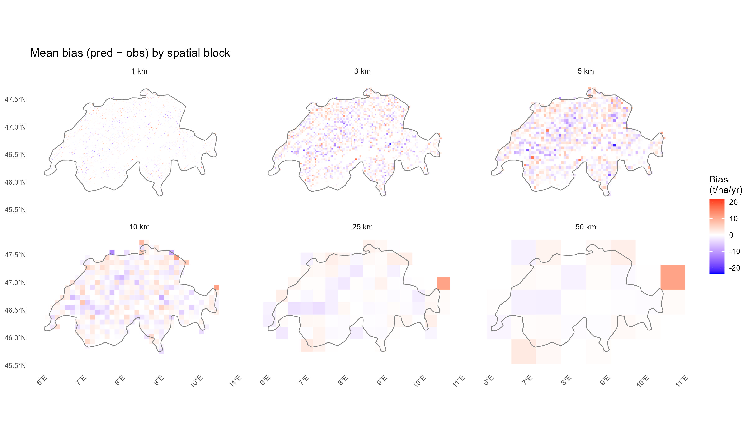

Carbon farming baseline - Results
Prediction error
Local mean error and its standard error (SE) reduce when aggregating the predictions
Better estimates for larger areas
Prediction mean error at varying spatial scales
3 Km
(2 plots/grid, SE: 0.87)
10 Km
(5 plots/grid, SE: 0.73)
25 Km
(20 plots/grid, SE: 0.52)
Mean errors for model PLOTS + MAPS – Example for Switzerland
Funded by the European Union. Views and opinions expressed are however those of the author(s) only and do not necessarily reflect those of the European Union or the European Climate, Infrastructure and Environment Executive Agency (CINEA). Neither the European Union nor the granting authority can be held responsible for them.

Slide 23
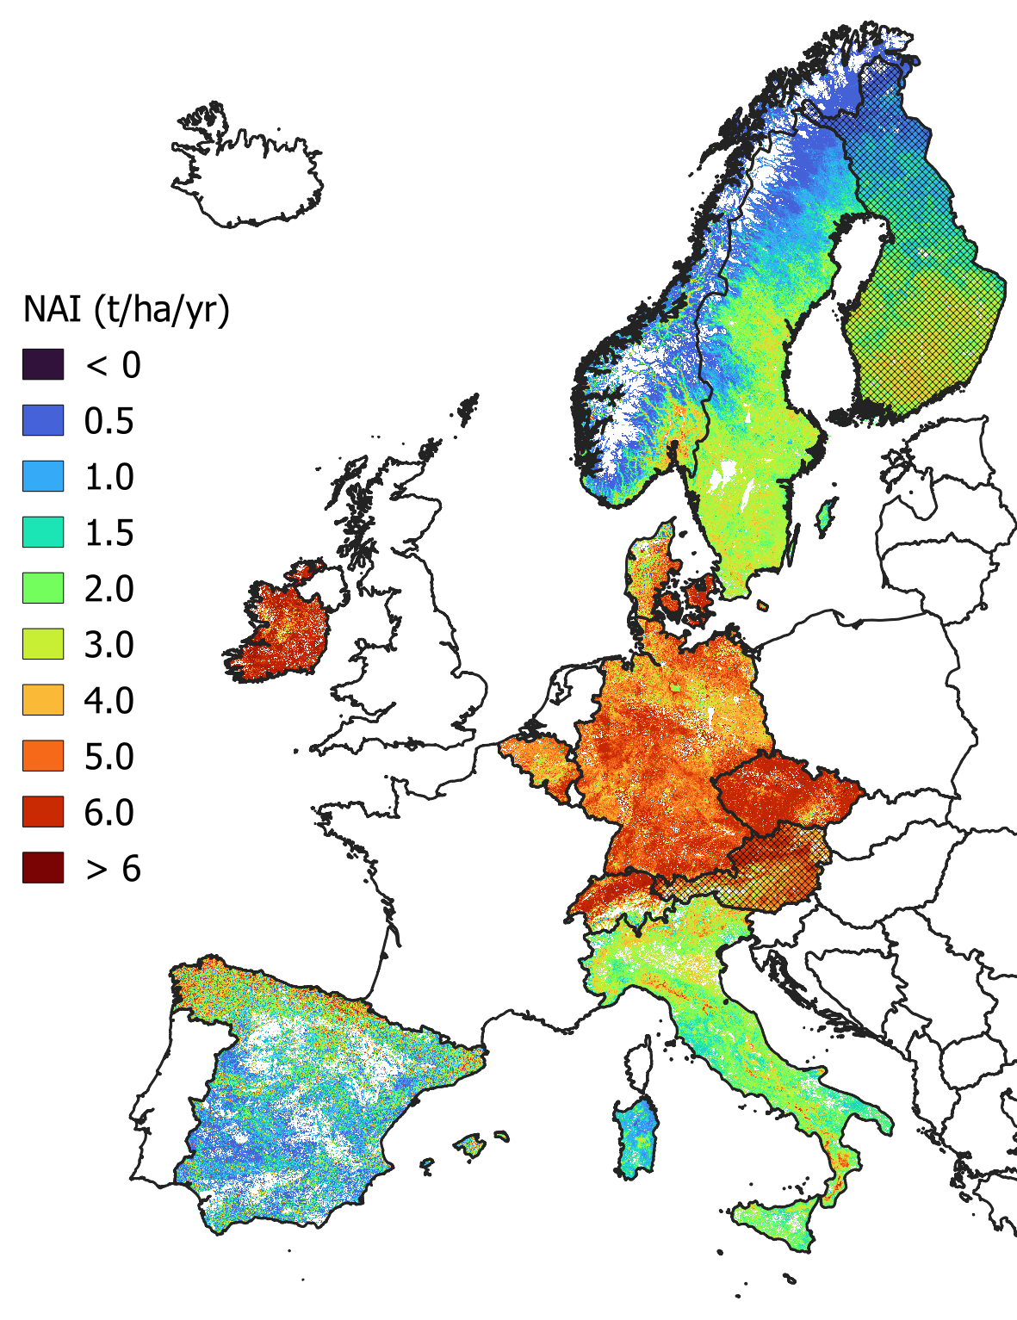

Carbon farming baseline - Mapping
Mapping forest increment
Predictors: EO maps
Based on country-specific models
Map for demonstration only (resolution: 1 Km)
Concept
Apply the method to develop national / local models and maps of forest growth and carbon removal
Calibrated predictive models are applicable without updated NFI data
AT, FI: model based on extrapolation of neighbouring countries
Funded by the European Union. Views and opinions expressed are however those of the author(s) only and do not necessarily reflect those of the European Union or the European Climate, Infrastructure and Environment Executive Agency (CINEA). Neither the European Union nor the granting authority can be held responsible for them.

Slide 24
Carbon farming baseline - Conclusions
Results
Data-driven approach for the standardized baseline
Relevance of integrating NFI field and EO data
Models applicable at various scales and periods
Limitations
Accuracy varies by country; spatial aggregation of predictions reduces uncertainty
Limited data on disturbances and management
Future directions
Refine models at country scale
Transform a research study into an operational MRV tool for the participating countries
Funded by the European Union. Views and opinions expressed are however those of the author(s) only and do not necessarily reflect those of the European Union or the European Climate, Infrastructure and Environment Executive Agency (CINEA). Neither the European Union nor the granting authority can be held responsible for them.

Slide 25
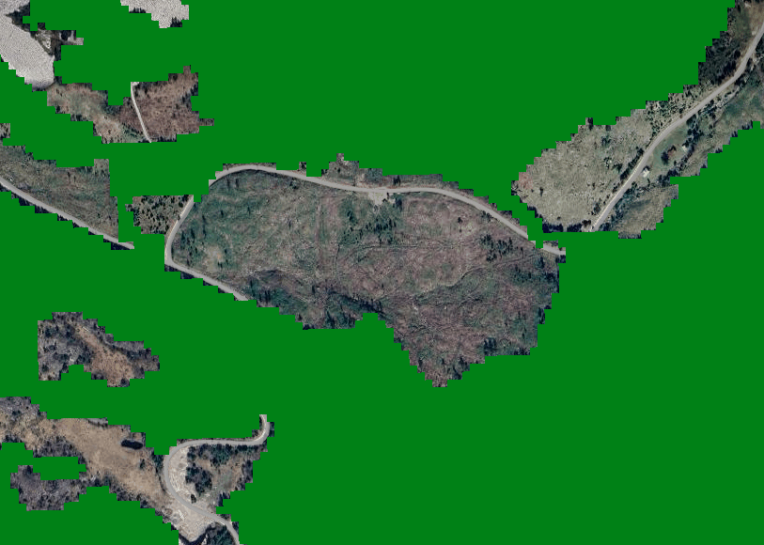
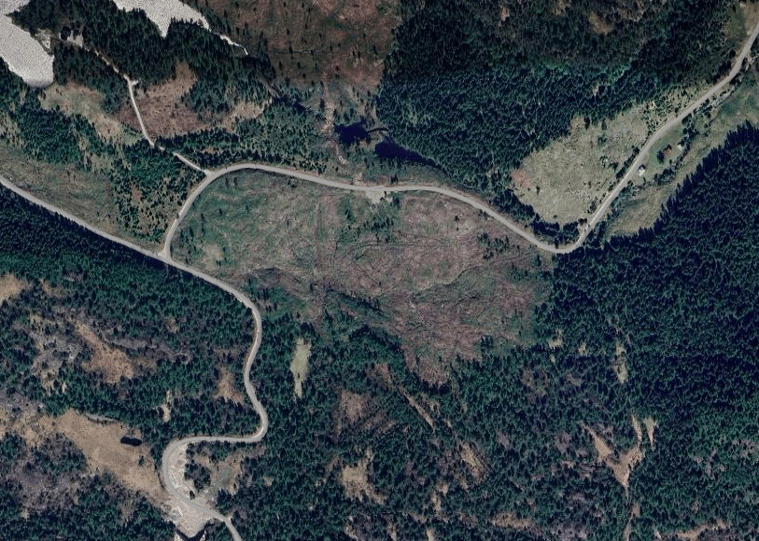
Forest Area Mapping
Unstocked forest
The requirement
Forest land-cover ≠ forest land-use
Temporarily unstocked forest can be mistaken for non-forested land
This leads to mismatch between national statistics and satellite based assessment
Remote sensing (Copernicus HRL forest cover map)
Validation with National Forest Inventories (NFI)
How to identify unstocked forests:
Use time series analysis to assess past and present conditions.
Detect changes in land use over time.
Funded by the European Union. Views and opinions expressed are however those of the author(s) only and do not necessarily reflect those of the European Union or the European Climate, Infrastructure and Environment Executive Agency (CINEA). Neither the European Union nor the granting authority can be held responsible for them.

Slide 26
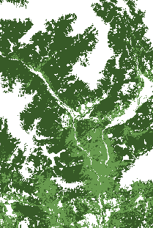
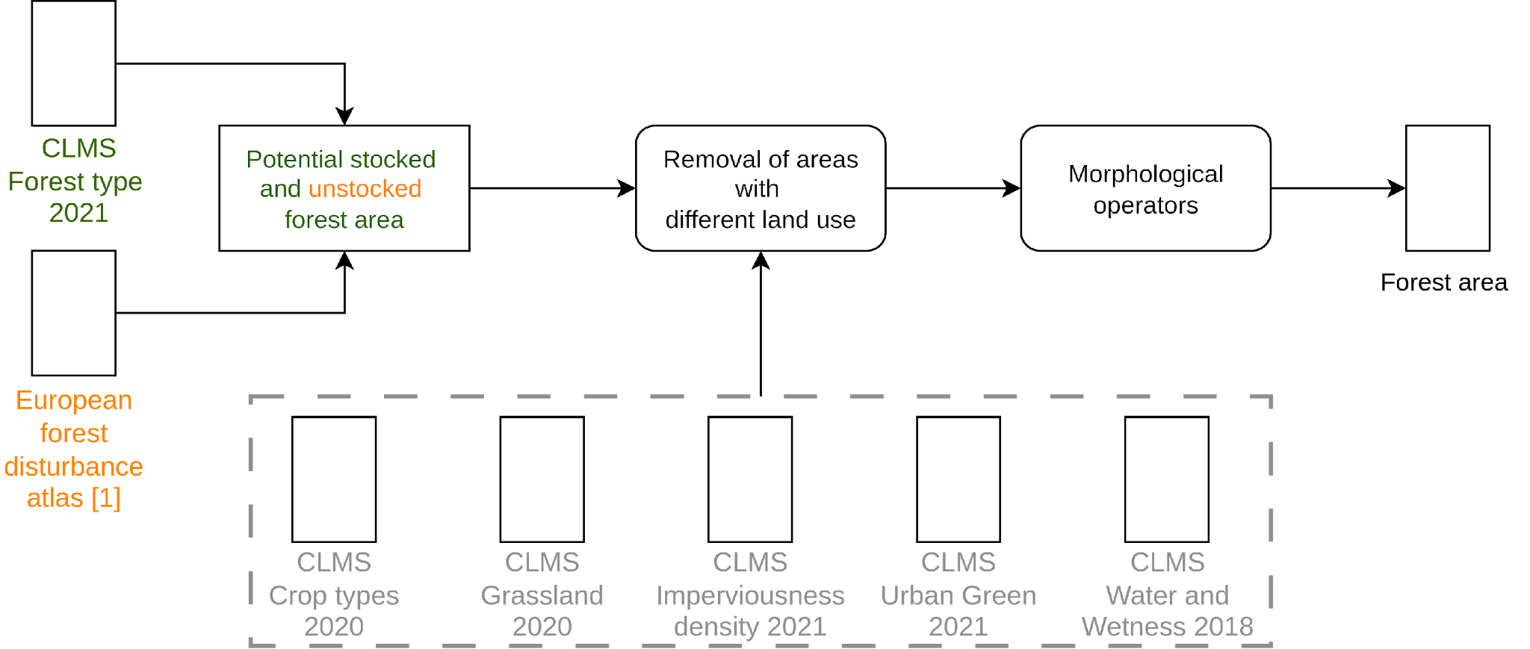
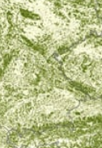
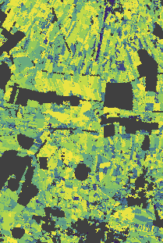
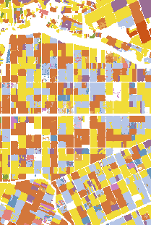
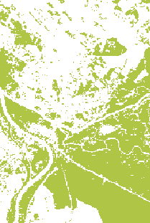
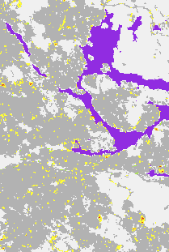
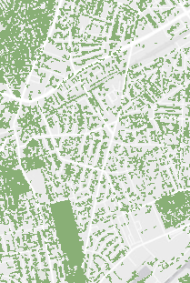

1
currently stocked forest as mapped by the CLMS forest type product.
2
forests disturbed in the last 30 years are potentially unstocked forests or areas subject to land use change.
3
disturbed forest areas under different land-cover by CLMS products are removed
[1] Viana-Soto, Alba, and Cornelius Senf. "The European Forest Disturbance Atlas: a forest disturbance monitoring system using the Landsat archive." Earth System Science Data, 2025.
Funded by the European Union. Views and opinions expressed are however those of the author(s) only and do not necessarily reflect those of the European Union or the European Climate, Infrastructure and Environment Executive Agency (CINEA). Neither the European Union nor the granting authority can be held responsible for them.
Notes:
High level only (don’t get stuck here)
“This framework integrates current forest cover with historical disturbance information over the past 30 years.
The idea is to reconstruct potential forest area using temporal information.”
Transition:
“This leads to two components.”

Slide 27


Forest Area Mapping - Results
Funded by the European Union. Views and opinions expressed are however those of the author(s) only and do not necessarily reflect those of the European Union or the European Climate, Infrastructure and Environment Executive Agency (CINEA). Neither the European Union nor the granting authority can be held responsible for them.

Slide 28
Forest Area Mapping - Results
Accuracy = (TP+TN) / (TP+TN+FP+FN) Precision = TP / (TP+FP) Recall = TP / (TP+FN)
Metric | Austria | Finland | Germany | Italy | Norway | Poland | Slovenia | Spain | Sweden
Accuracy | 93.74 | 91.09 | 95.44 | 88.37 | 90.81 | 95.28 | 94.40 | 85.60 | 90.80
Precision | 93.74 | 93.42 | 88.30 | 90.20 | 93.94 | 91.98 | 93.11 | 86.50 | 93.34
Recall | 92.70 | 92.93 | 97.25 | 88.98 | 87.40 | 94.34 | 97.89 | 64.82 | 91.10
Funded by the European Union. Views and opinions expressed are however those of the author(s) only and do not necessarily reflect those of the European Union or the European Climate, Infrastructure and Environment Executive Agency (CINEA). Neither the European Union nor the granting authority can be held responsible for them.

Slide 29


Forest Area Mapping - Results
Funded by the European Union. Views and opinions expressed are however those of the author(s) only and do not necessarily reflect those of the European Union or the European Climate, Infrastructure and Environment Executive Agency (CINEA). Neither the European Union nor the granting authority can be held responsible for them.

Slide 30
Forest Area Mapping - Conclusions
Developed a framework to map forest area (both stocked and unstocked) by integrating temporal information through a historic disturbance product.
The estimated forest area shows a +2.6% increase compared to existing forest cover products, improving recall while keeping stable precision.
Limitations
Results are dependent on the quality of input datasets.
Land cover products (e.g., grassland) can introduce systematic errors.
The disturbance Atlas 30 m resolution often misses small disturbed areas.
Future Developments
The framework is modular and can be easily updated as new datasets become available.
Integrating higher-resolution disturbance data (e.g., Sentinel-2).
Funded by the European Union. Views and opinions expressed are however those of the author(s) only and do not necessarily reflect those of the European Union or the European Climate, Infrastructure and Environment Executive Agency (CINEA). Neither the European Union nor the granting authority can be held responsible for them.

Slide 31

Thank you for your attention!
Contact Information of WP2 task leaders:
Ivo Kohn, NLI
ivo.kohn@nli.gov.cz
nFIESTA
Estimates
WP2 overall
Mari Myllymäki, Luke
mari.myllymaki@luke.fi
Jukka Miettinen, VTT
jukka.miettinen@vtt.fi
Data portal
Maps
Mirco Migliavacca, JRC
mirco.migliavacca@ec.europa.eu
CRCF analysis
Forest area analysis
Contributors:
Natural Resources Institute Finland (Luke): Mari Myllymäki, Andras Balazs, Annika Kangas, Mikko Kuronen and Juho Pitkänen
Czech Forestry Institute (NLI), Czechia: Radim Adolt, Ivo Kohn, Others?
EC Joint Research Centre (JRC), Italy: Mirco Migliavacca, Alessandro Cescatti, Valerio Avitabile and Daniele Marinelli
Norwegian Institute of Bioeconomy Research (NIBIO), Norway: Johannes Breidenbach, Zsofia Koma, Others?
VTT Technical Research Centre of Finland: Jukka Miettinen, Laura Sirro and Lauri Seitsonen
Funded by the European Union. Views and opinions expressed are however those of the author(s) only and do not necessarily reflect those of the European Union or the European Climate, Infrastructure and Environment Executive Agency (CINEA). Neither the European Union nor the granting authority can be held responsible for them.
Notes:
Concluding/contact slide

